Slide 1
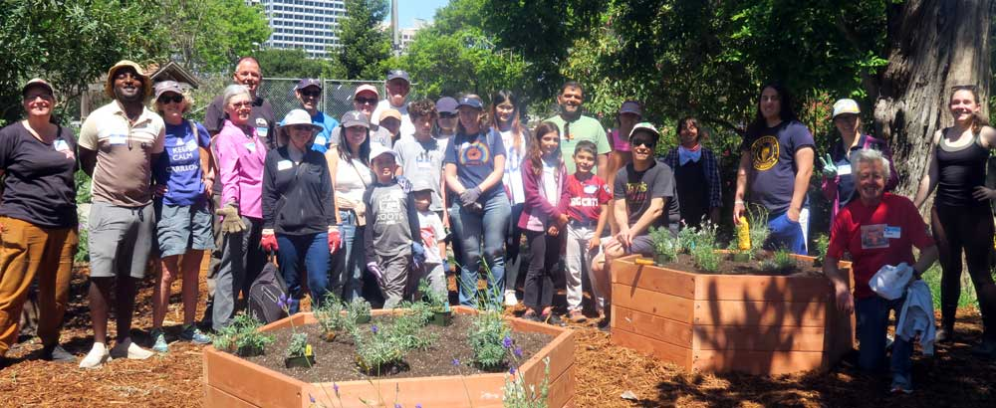
Yale Blue Green Chapters:
Our Alumni in Sustainability
Brief history, current work, & future plans

Slide 2
YBG Chapters Chair Presenters
Paul Chapman, YC ’70: Retired Educator, School Consultant
Martin Man, MArch ‘19: Urban Designer, Prior + Partners
Margot McMahon, MFA ’84: Eco-Artist, Author
Barbara Tyran, SOM ’79: Global America Business Institute
Emily Hendrick, YC ’04: Sustainability Advisor
Angela Lee, YC ’14, MPH ’16: Kaiser Health Care Consultant
Sarah Ichioka, YC ’01: Founding Director, Desire Lines

Slide 3
YBG Chapters: History and Mission
Yale Blue Green SIG founded in 2011, Chapters envisioned in 2014-15
Launched in LA, NYC, Chicago, DC, Boston, and SF 2015-2020
Pandemic hibernation 2020, resurrection 2022 and ongoing
YBG Mission: “Our mission is to serve as an alumni hub for thought leadership, collaborative action, lifelong learning and inspiration on initiatives promoting environmental sustainability and to liaise with the University in its sustainability efforts.”
Purpose: Chapters are an opportunity for alums to connect with fellow alums, build community, participate in social activities and service projects, and engage with environmental and sustainability issues unique to their area.
Chapter Focus: Nature, Service, Networking, Education, Activism

Slide 4
Current Organization of YBG Chapters
Original Chapters: Boston, New York, Washington DC, Chicago, SF
New and Emerging Chapters: London, New Haven, San Antonio, Colorado, Singapore, Oregon
Class Chapters: Launched with Y94
Thematic Chapters: In development
Leadership: Typically includes Co-Chairs
Communication: YBG Chapters website, Mailchimp, individual chapter newsletters
Yale Day of Service 2026: 9 chapters, 12 projects, ~ 150 vols!

Slide 5
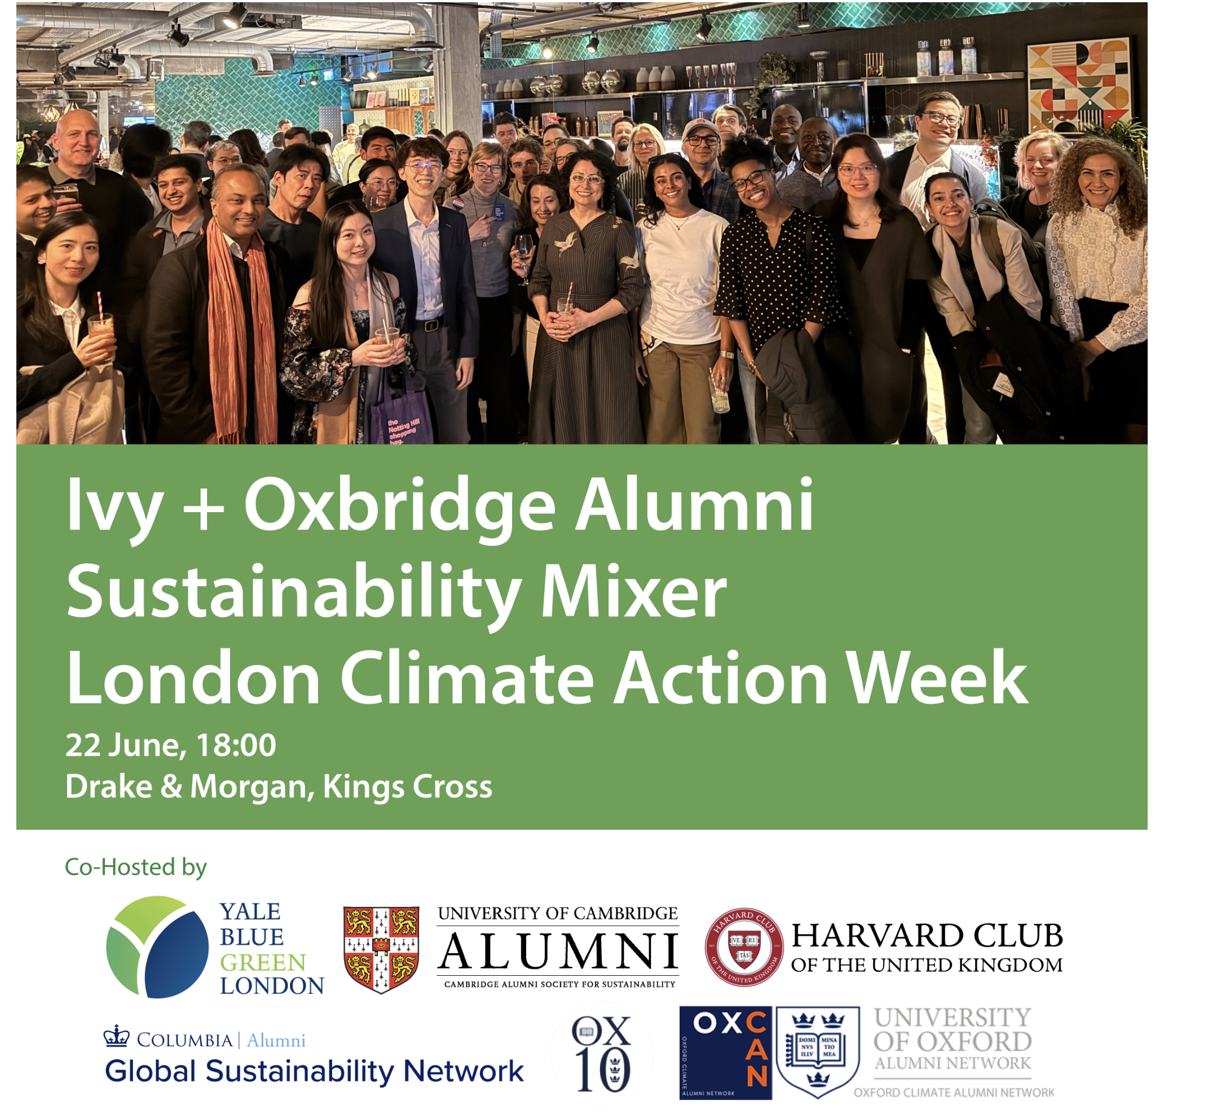
YBG London: Sustainability Mixer

Slide 6
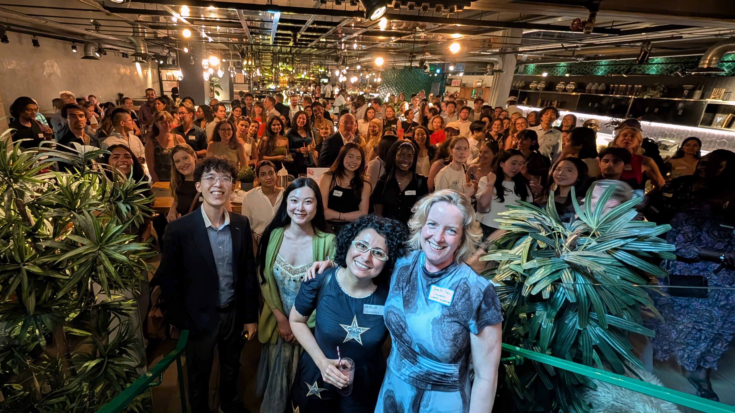
YBG London: Climate Action Week

Slide 7
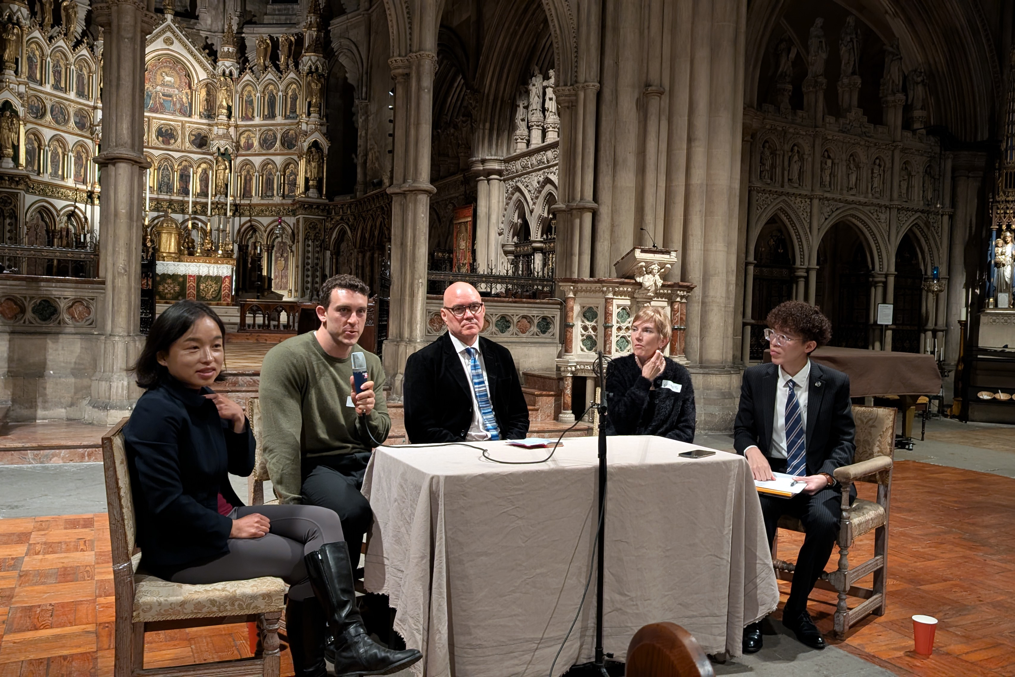
YBG London: Sustainable Development Panel

Slide 8
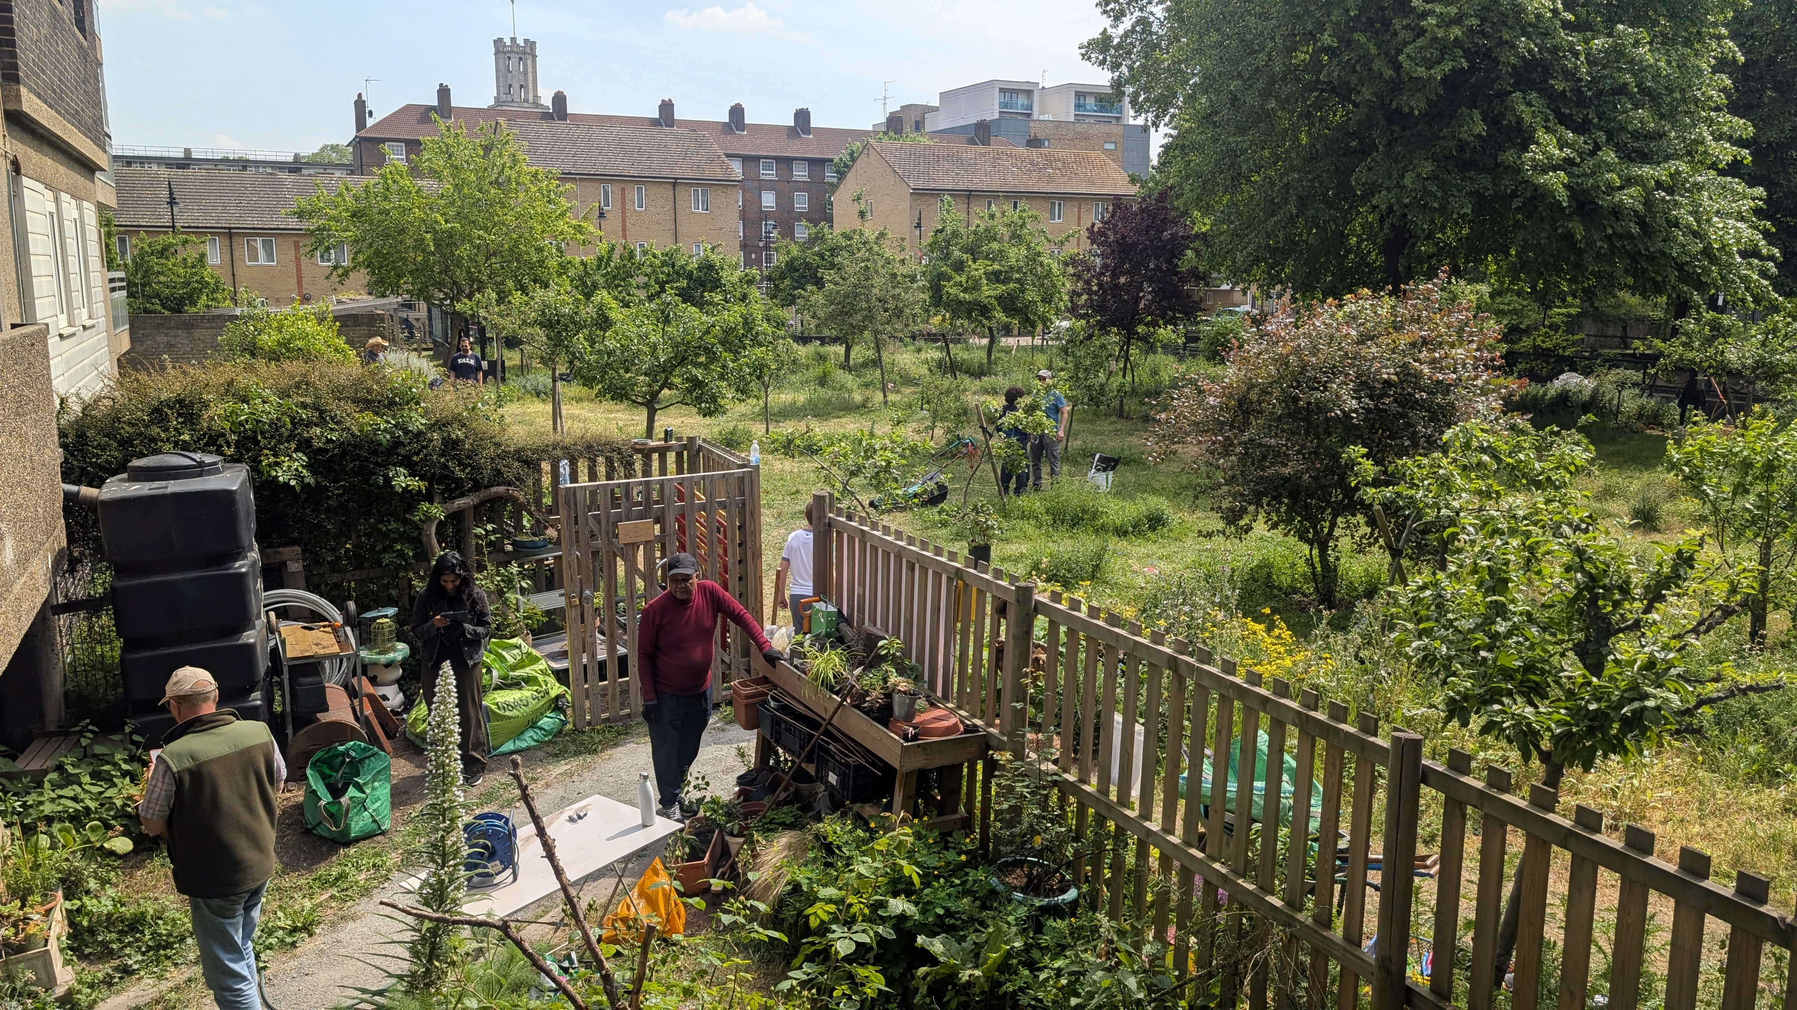
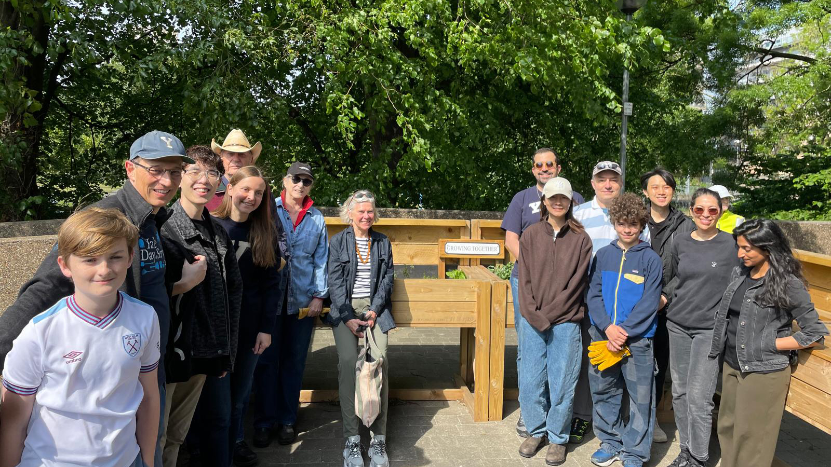
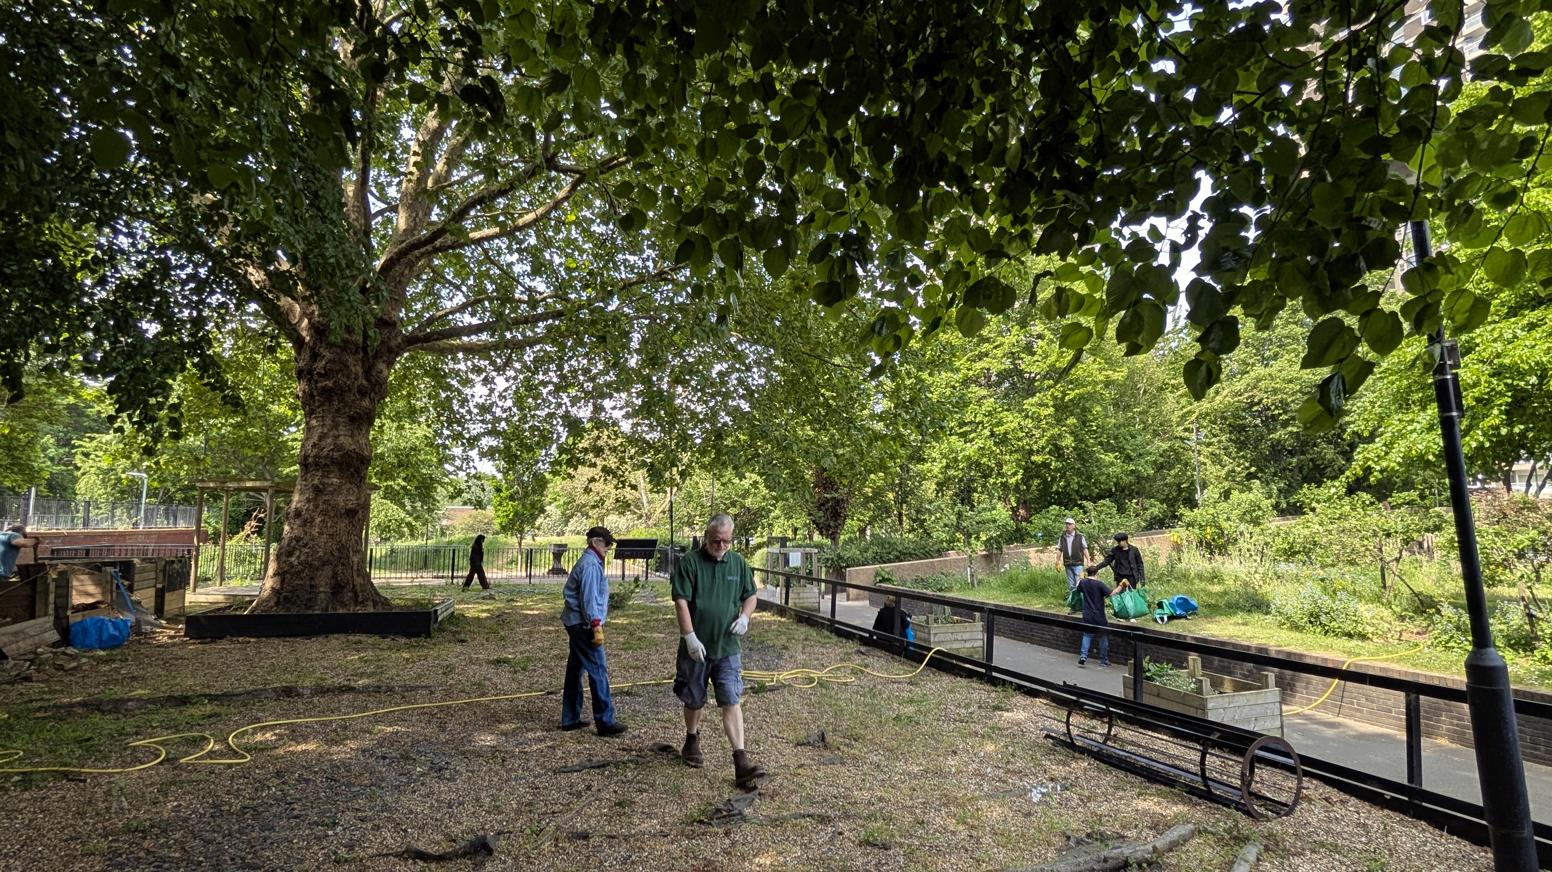
YBG London: Yale Day of Service - East End Homes Community Gardening

Slide 9
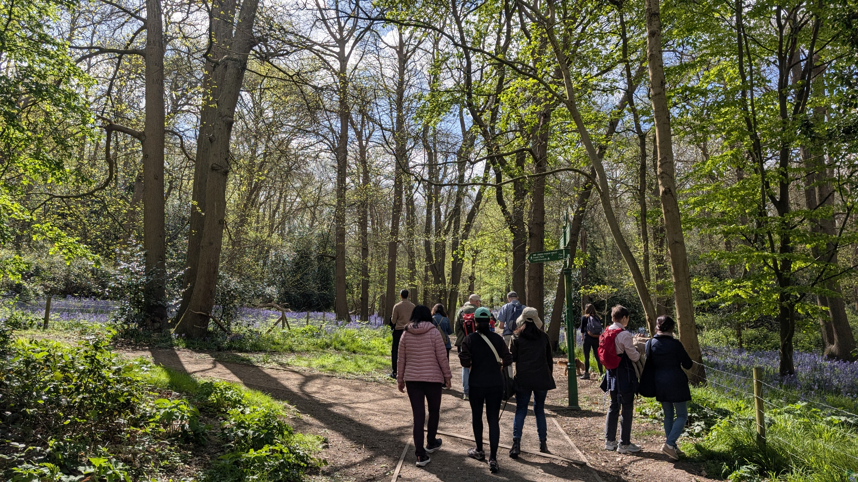
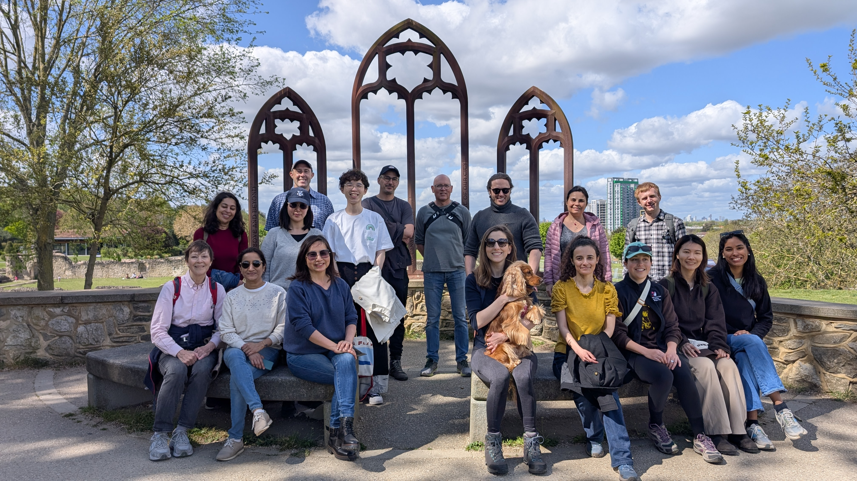
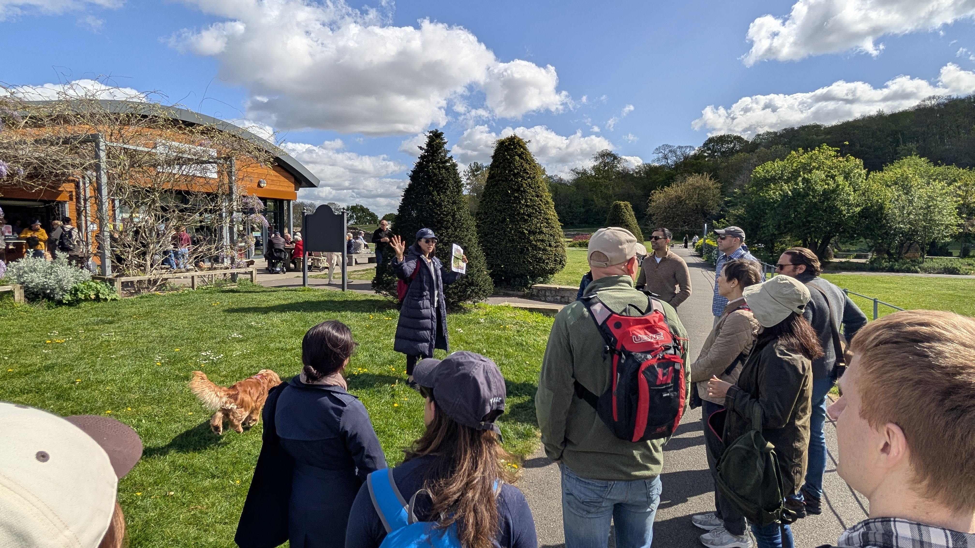
YBG London: Bluebells Walk

Slide 10
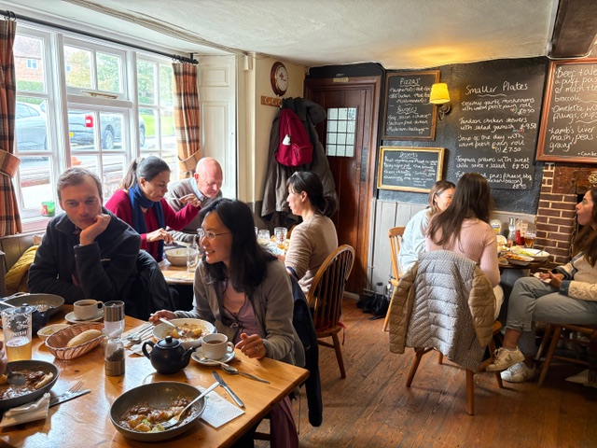
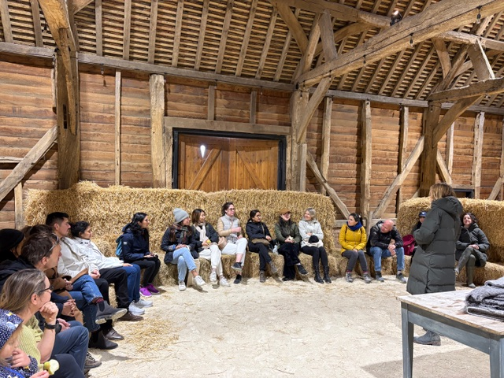
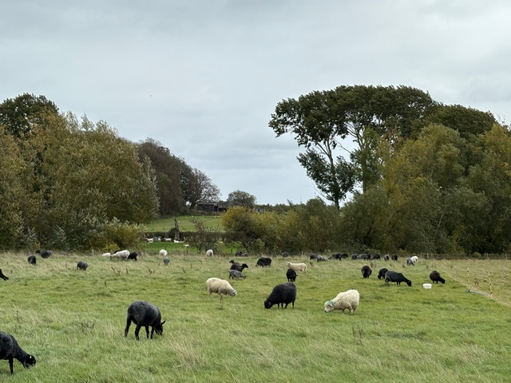
YBG London: Organic Farm Trip

Slide 11
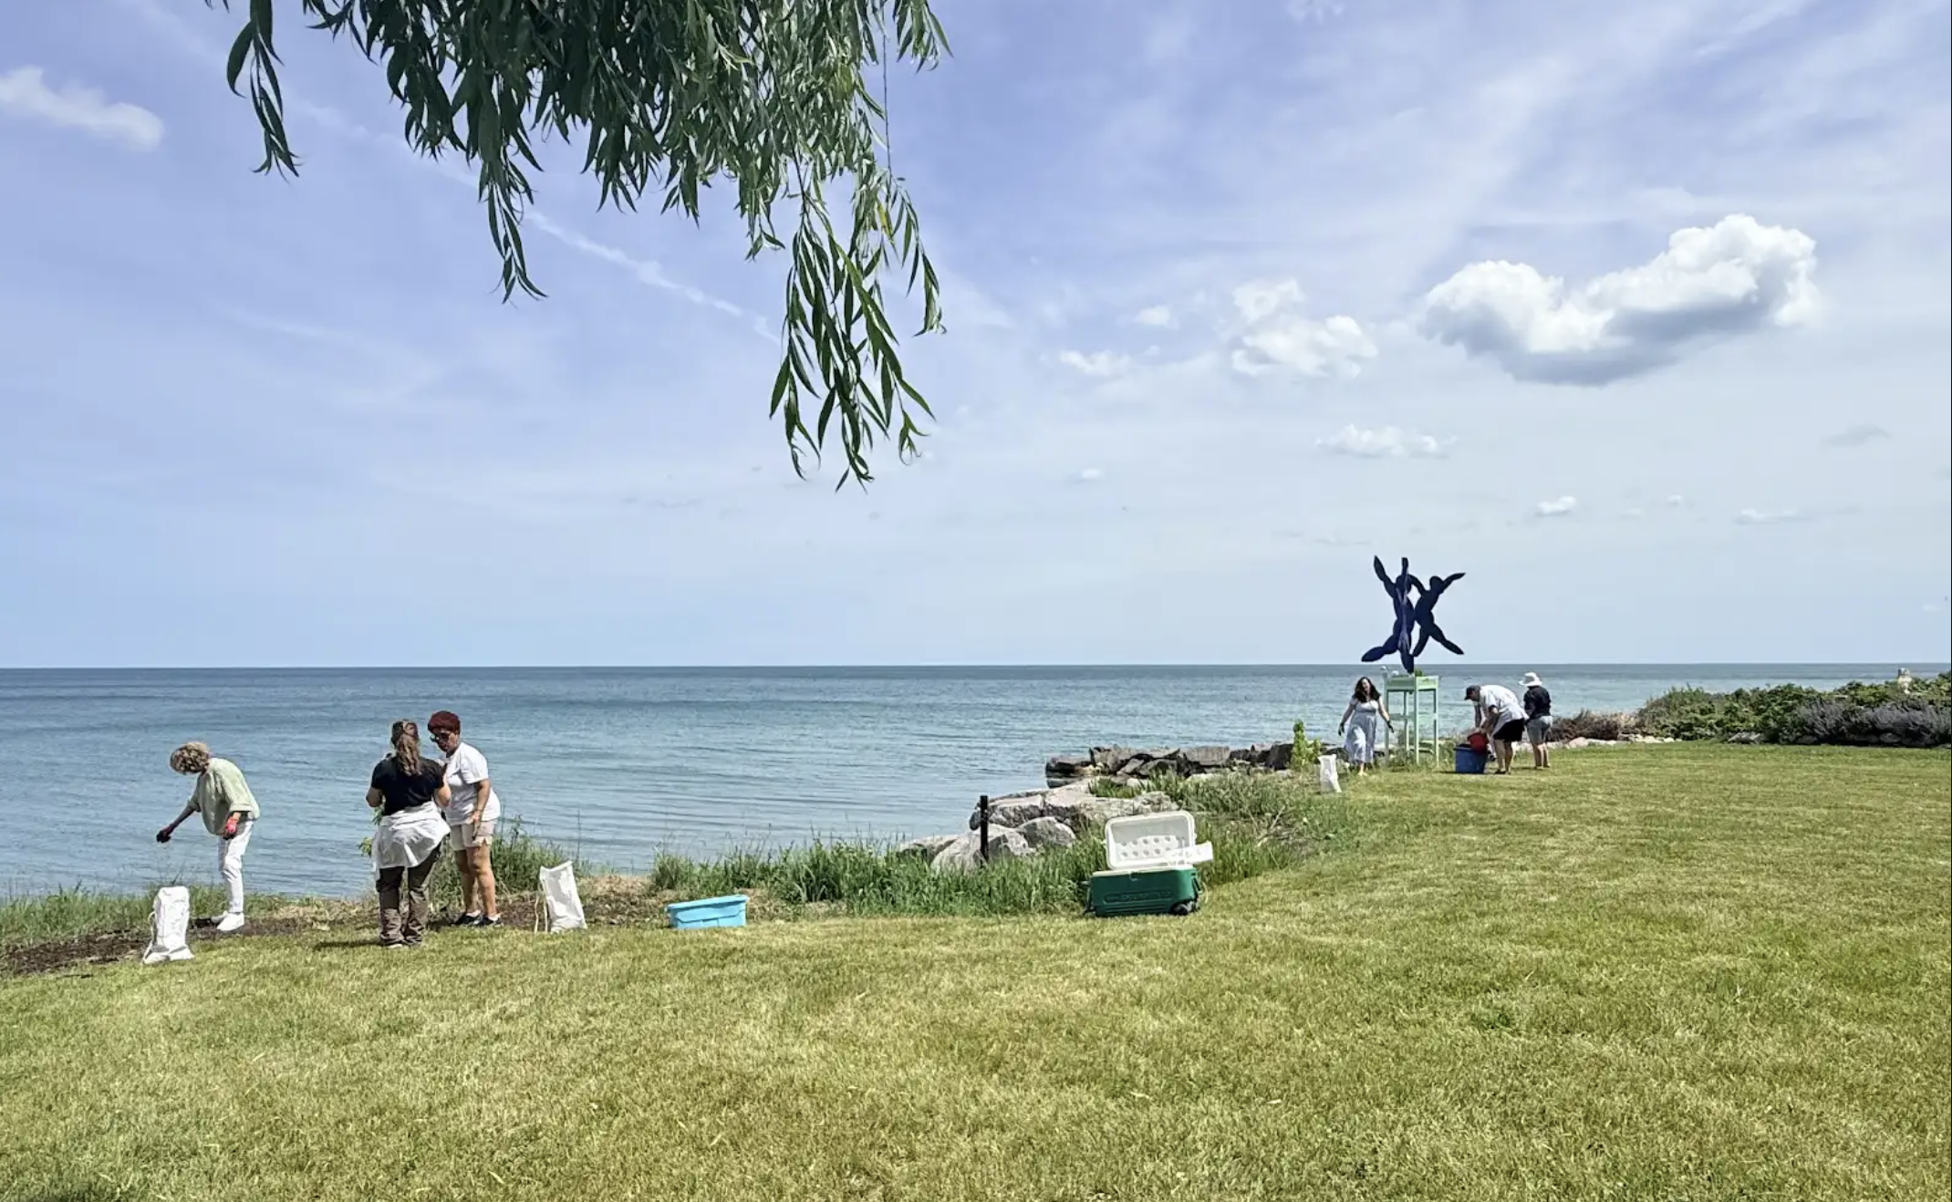
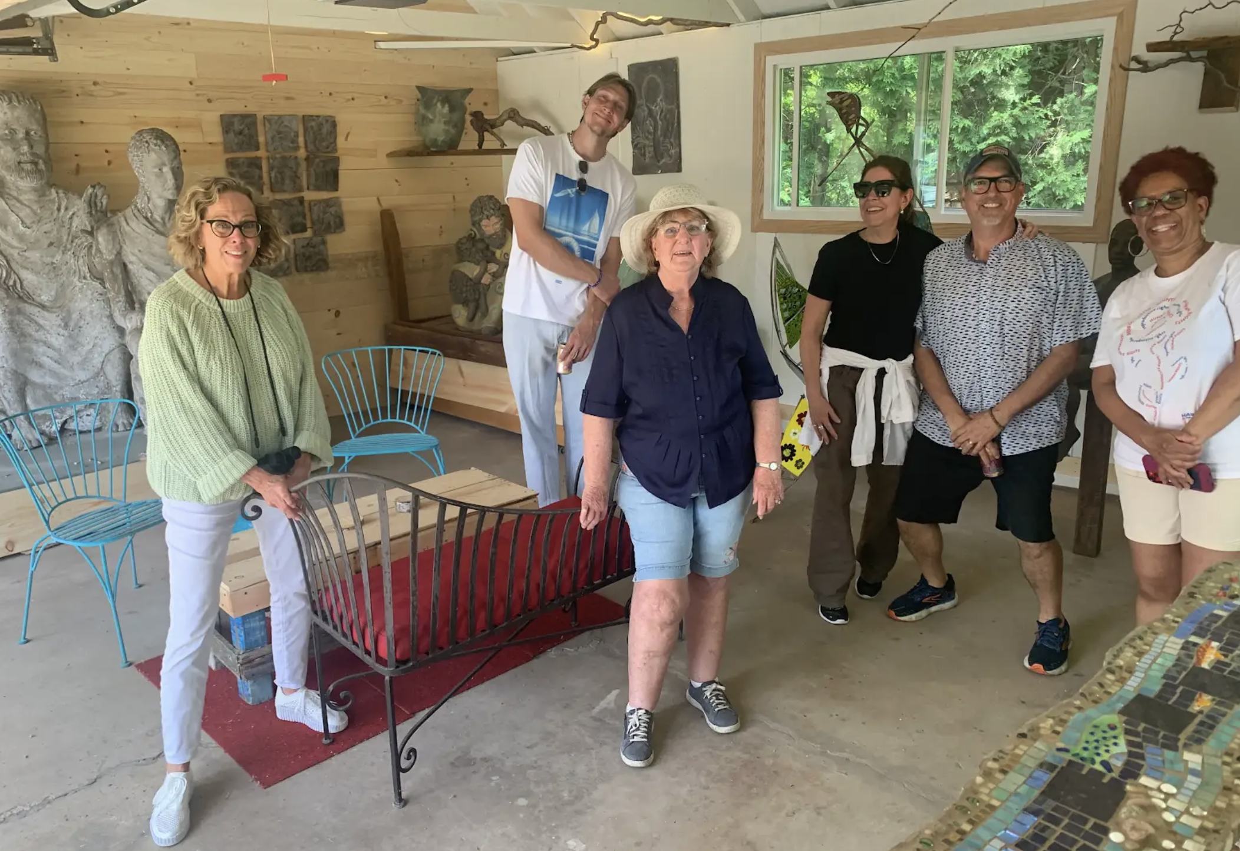
YBG Chicago: Anam Cara Eco-Art Space Chiwaukee
Prairie seeding on Lake Michigan https://www.margotmcmahon.com/anamcara.html

Slide 12
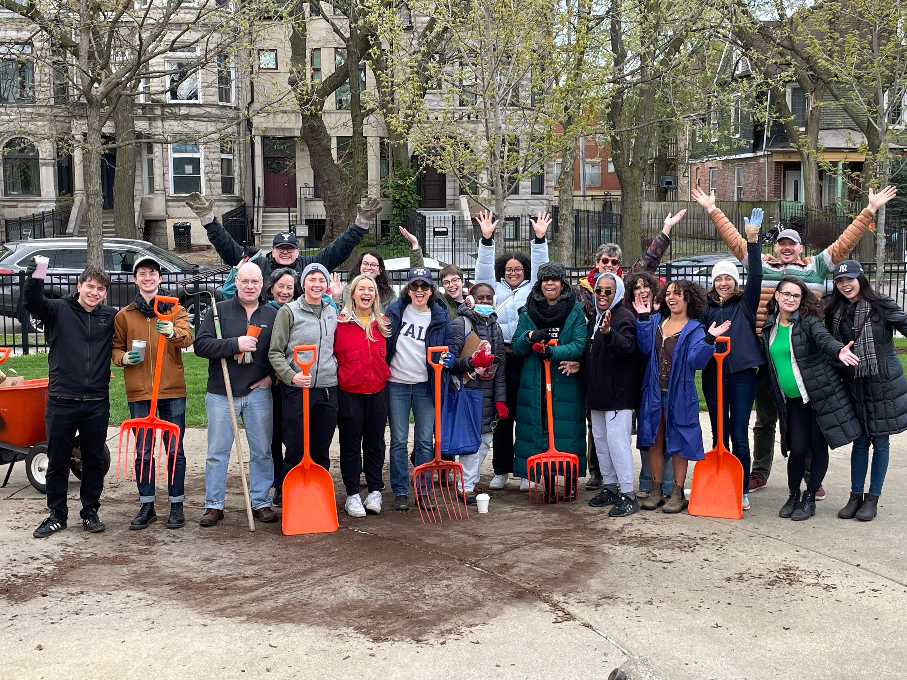
YBG Chicago: Earth Day Sapling Care Poetry

Slide 13
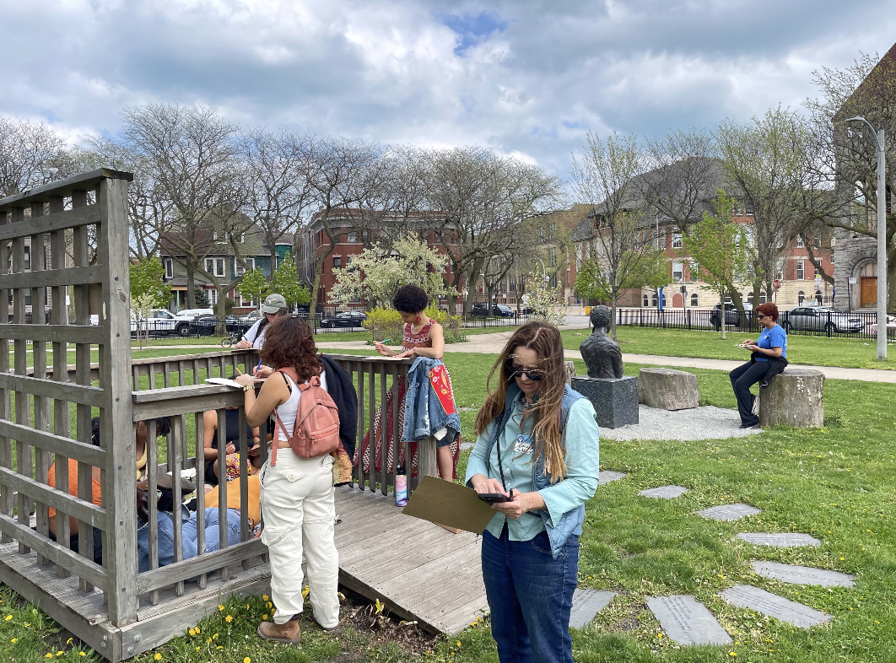
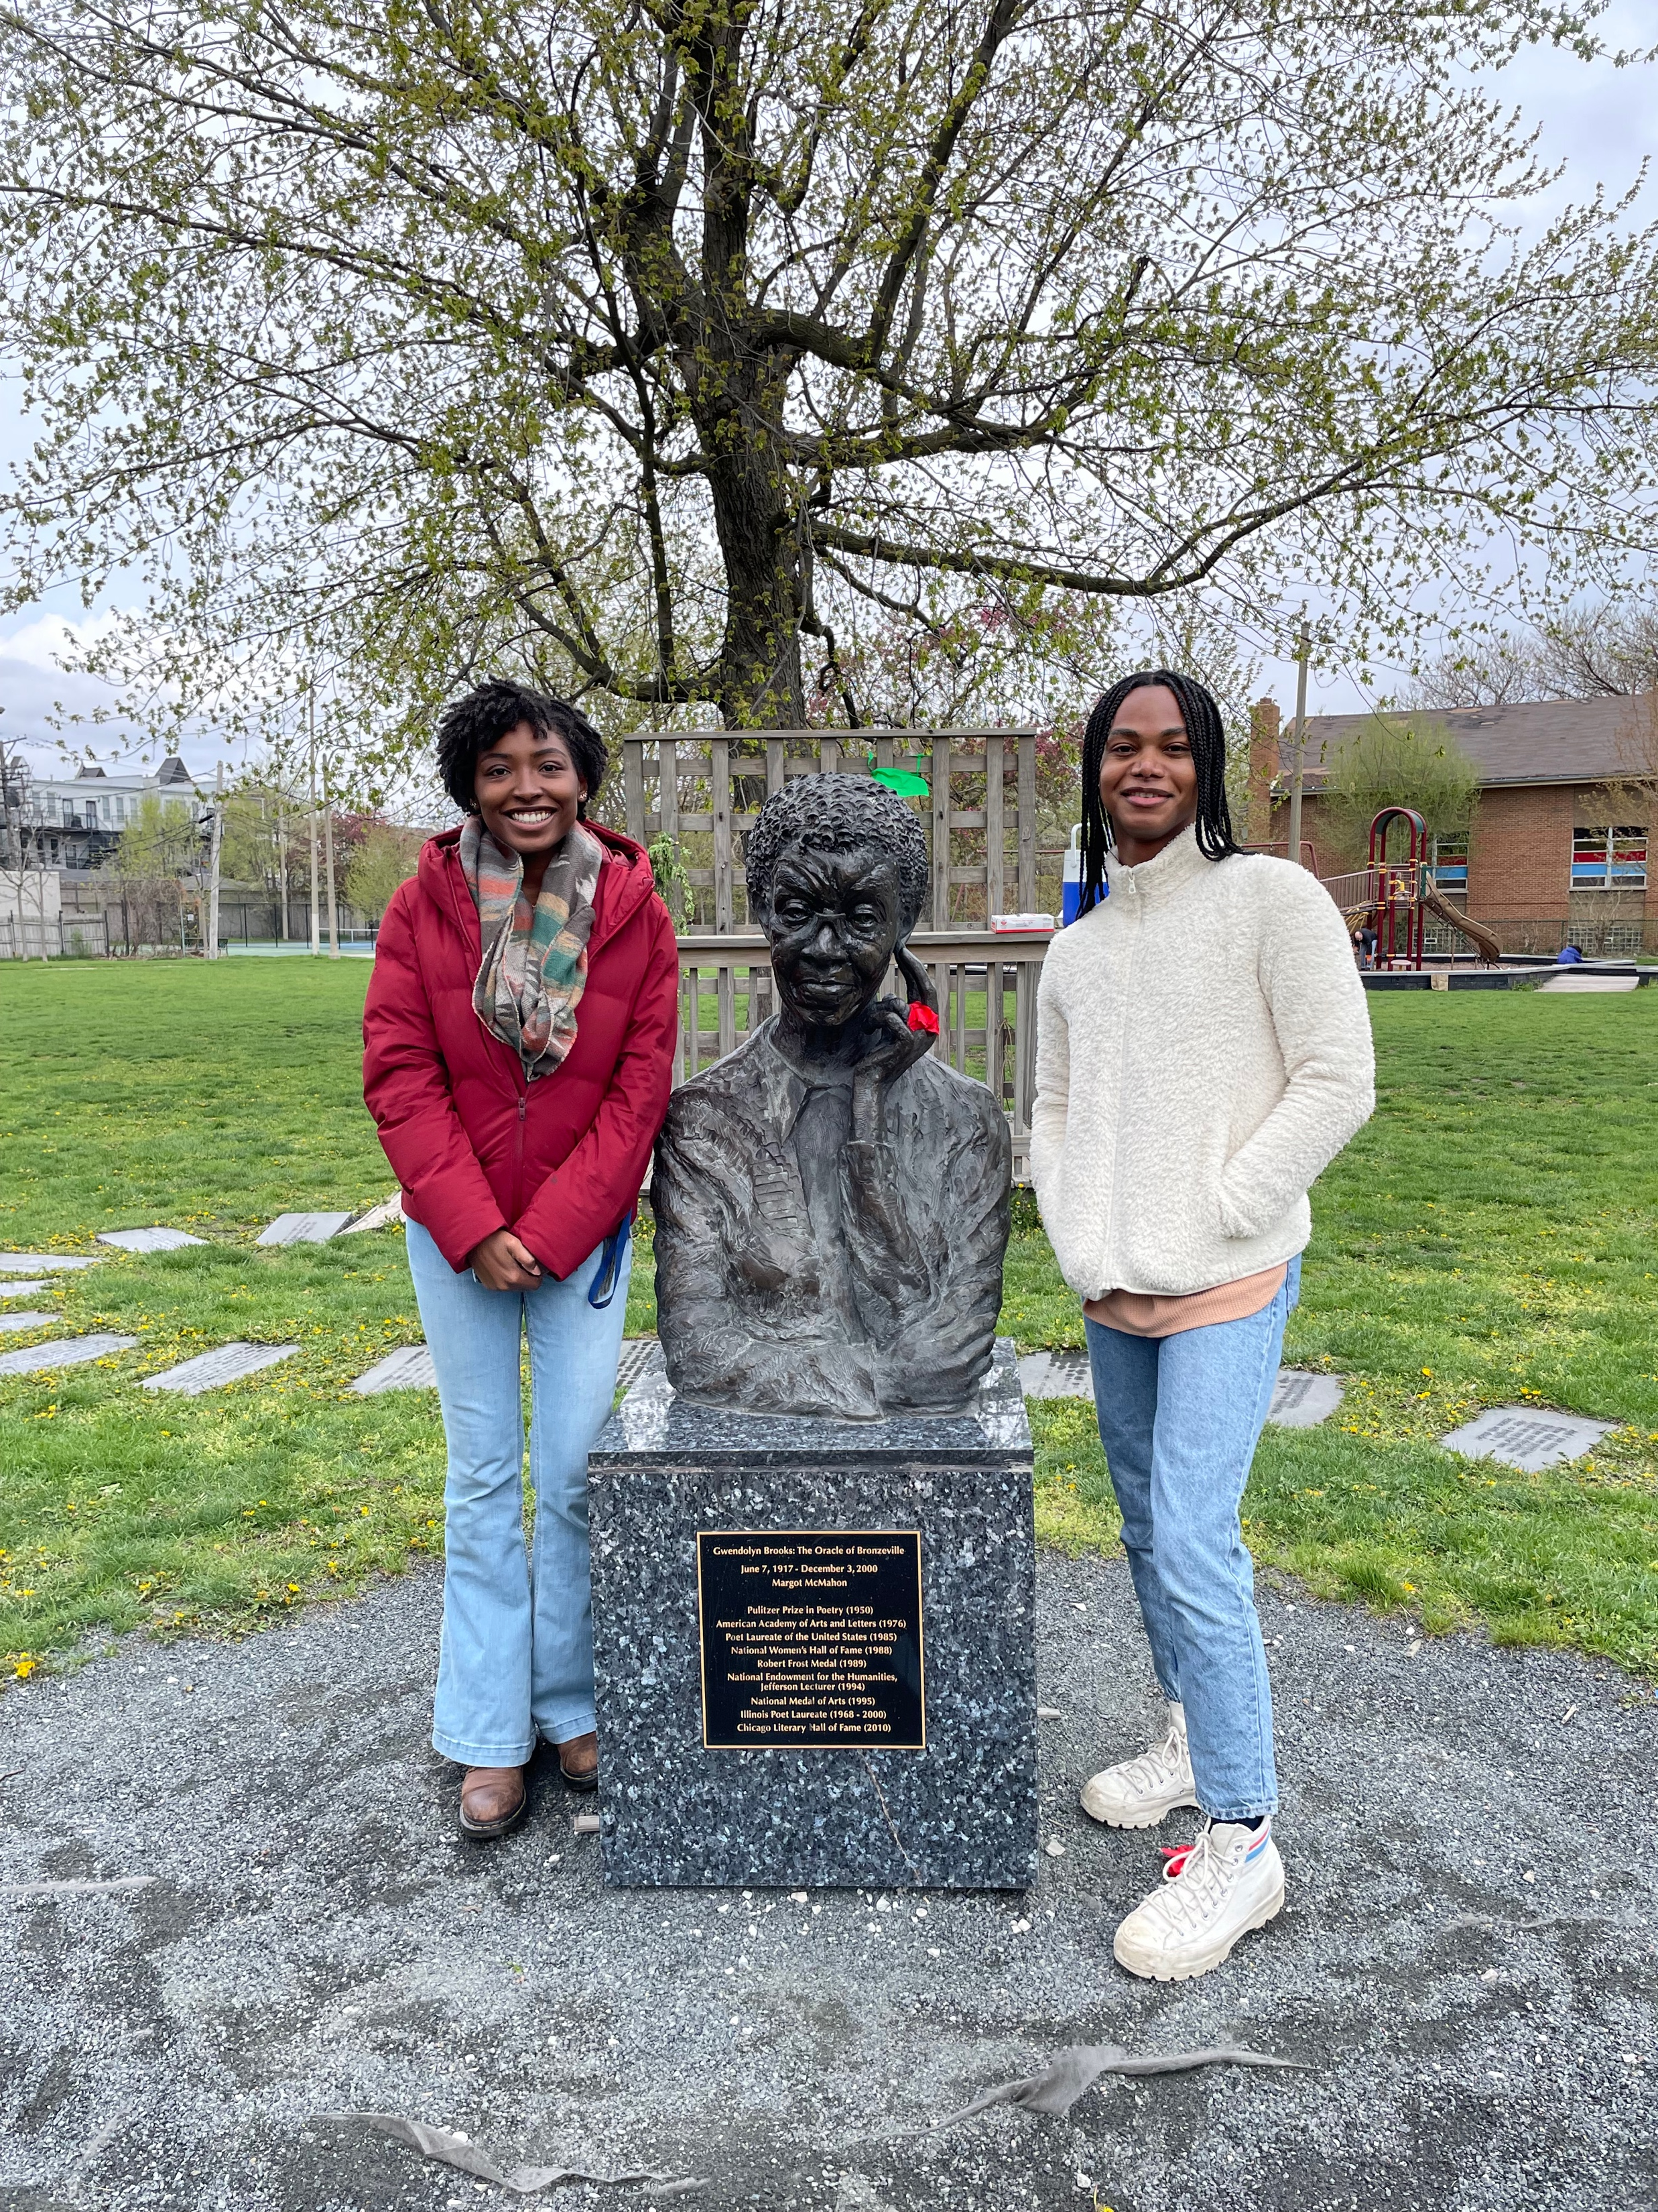
YBG Chicago: Gwendolyn Brooks Monument and Poetry Workshop

Slide 14
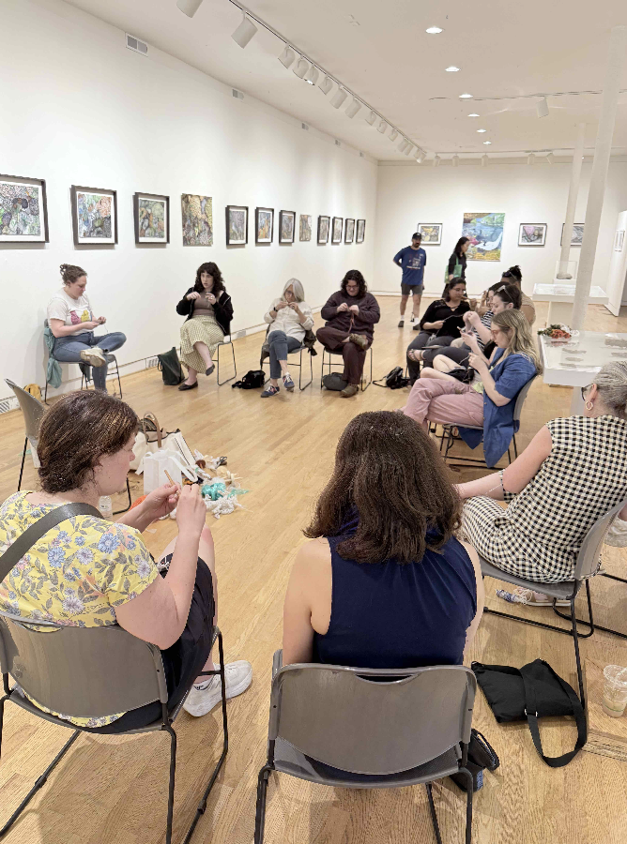
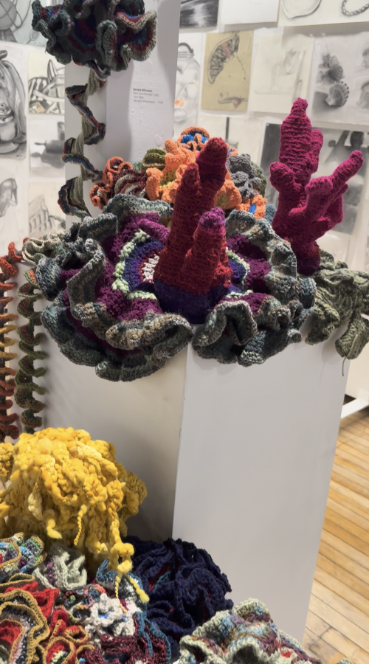
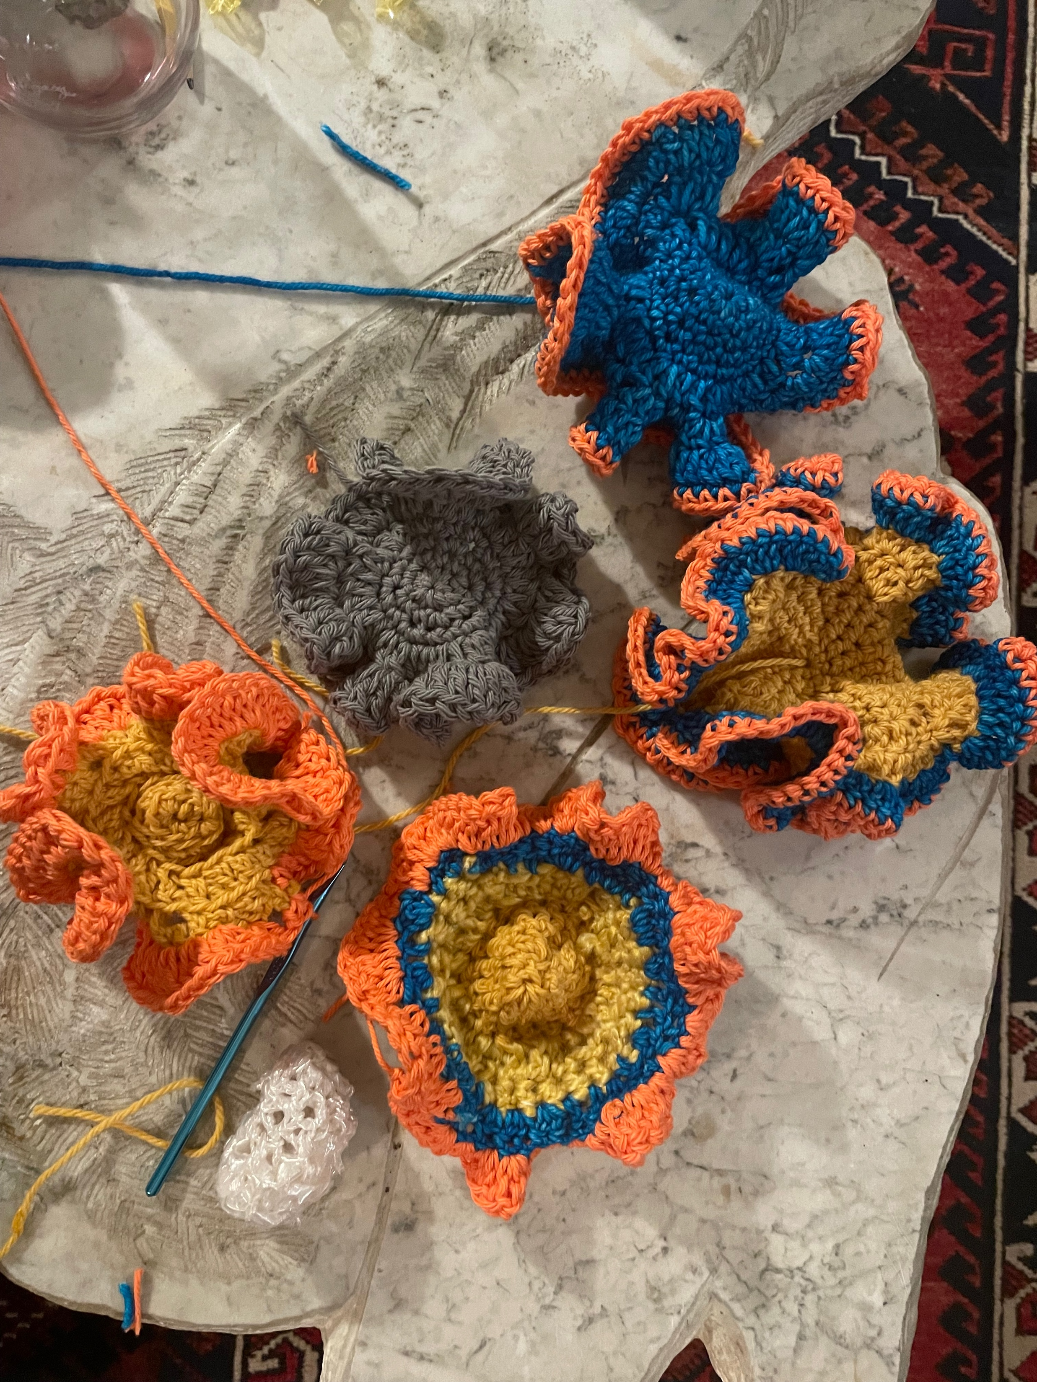
YBG Chicago: Crocheting Plarn Coral Reefs

Slide 15
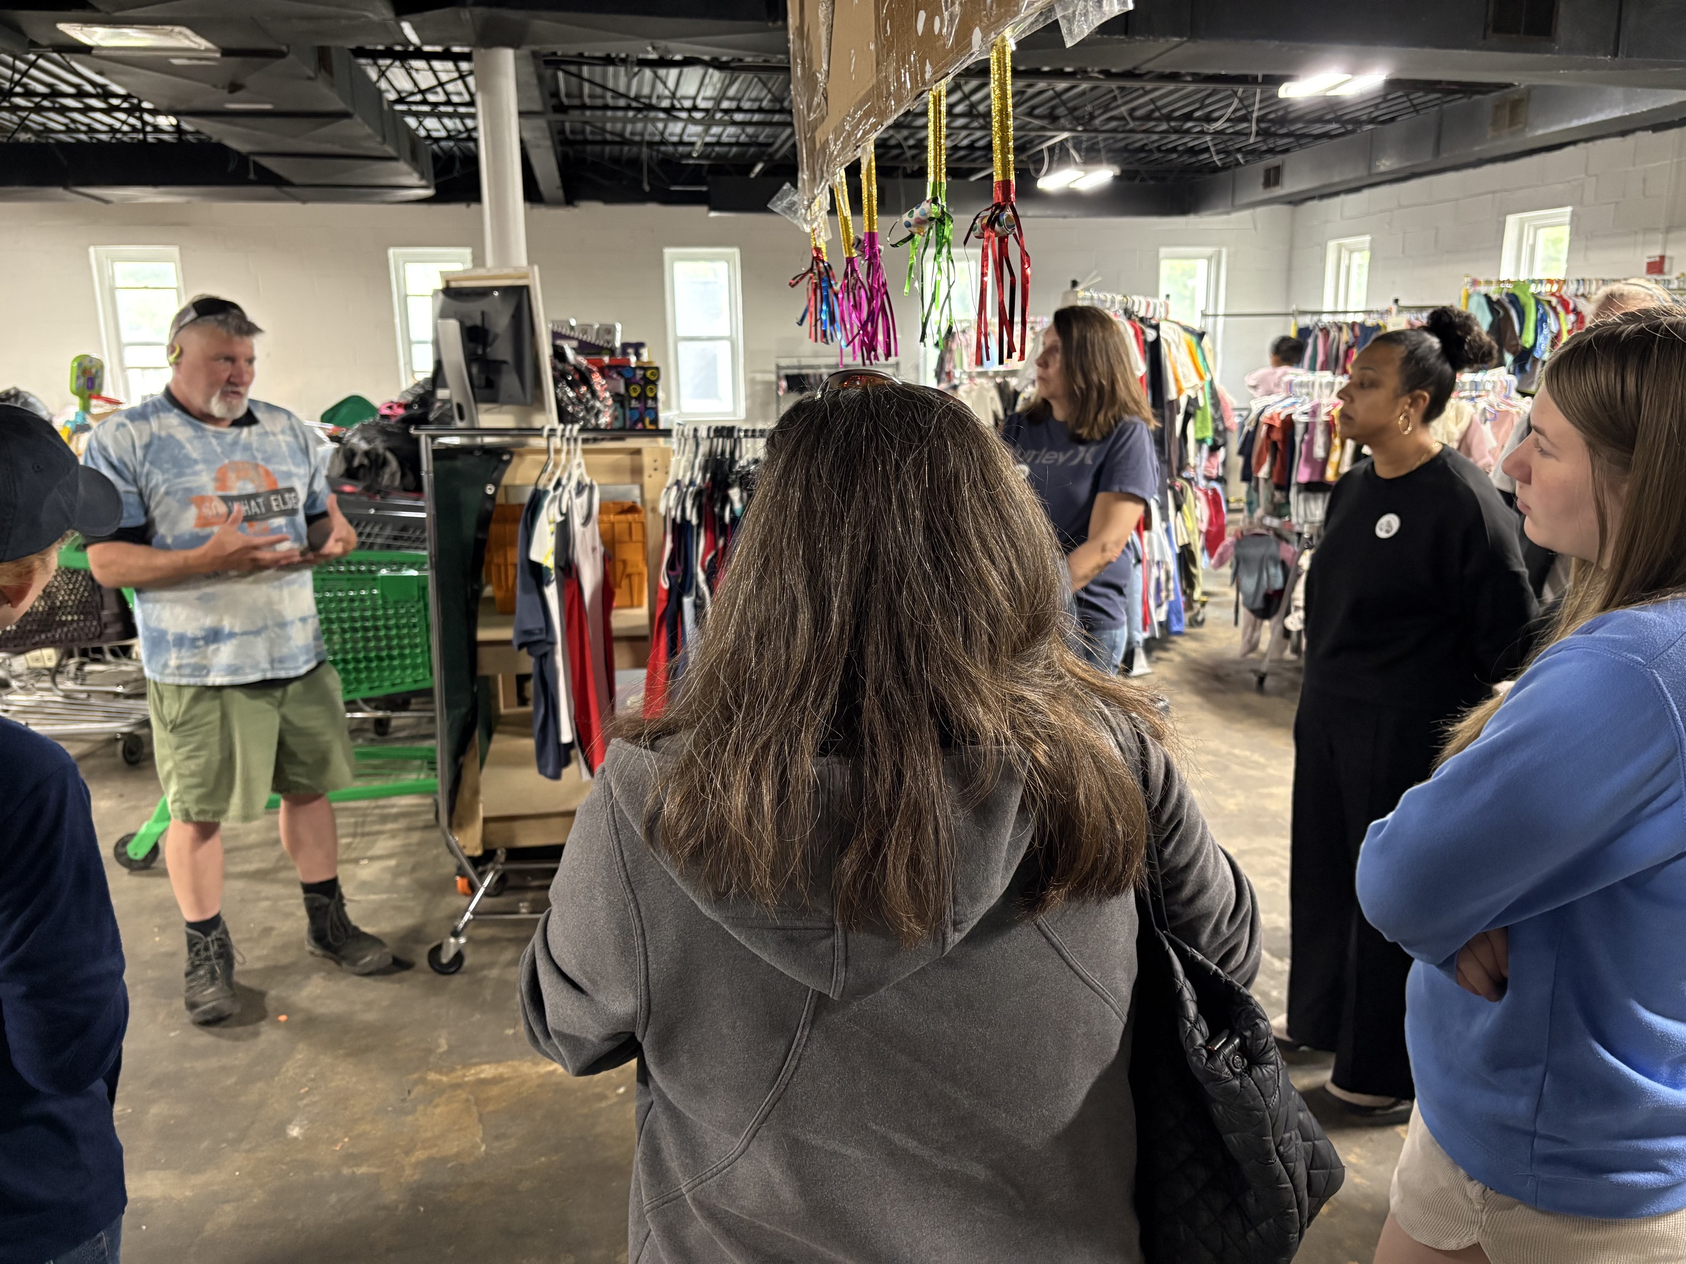
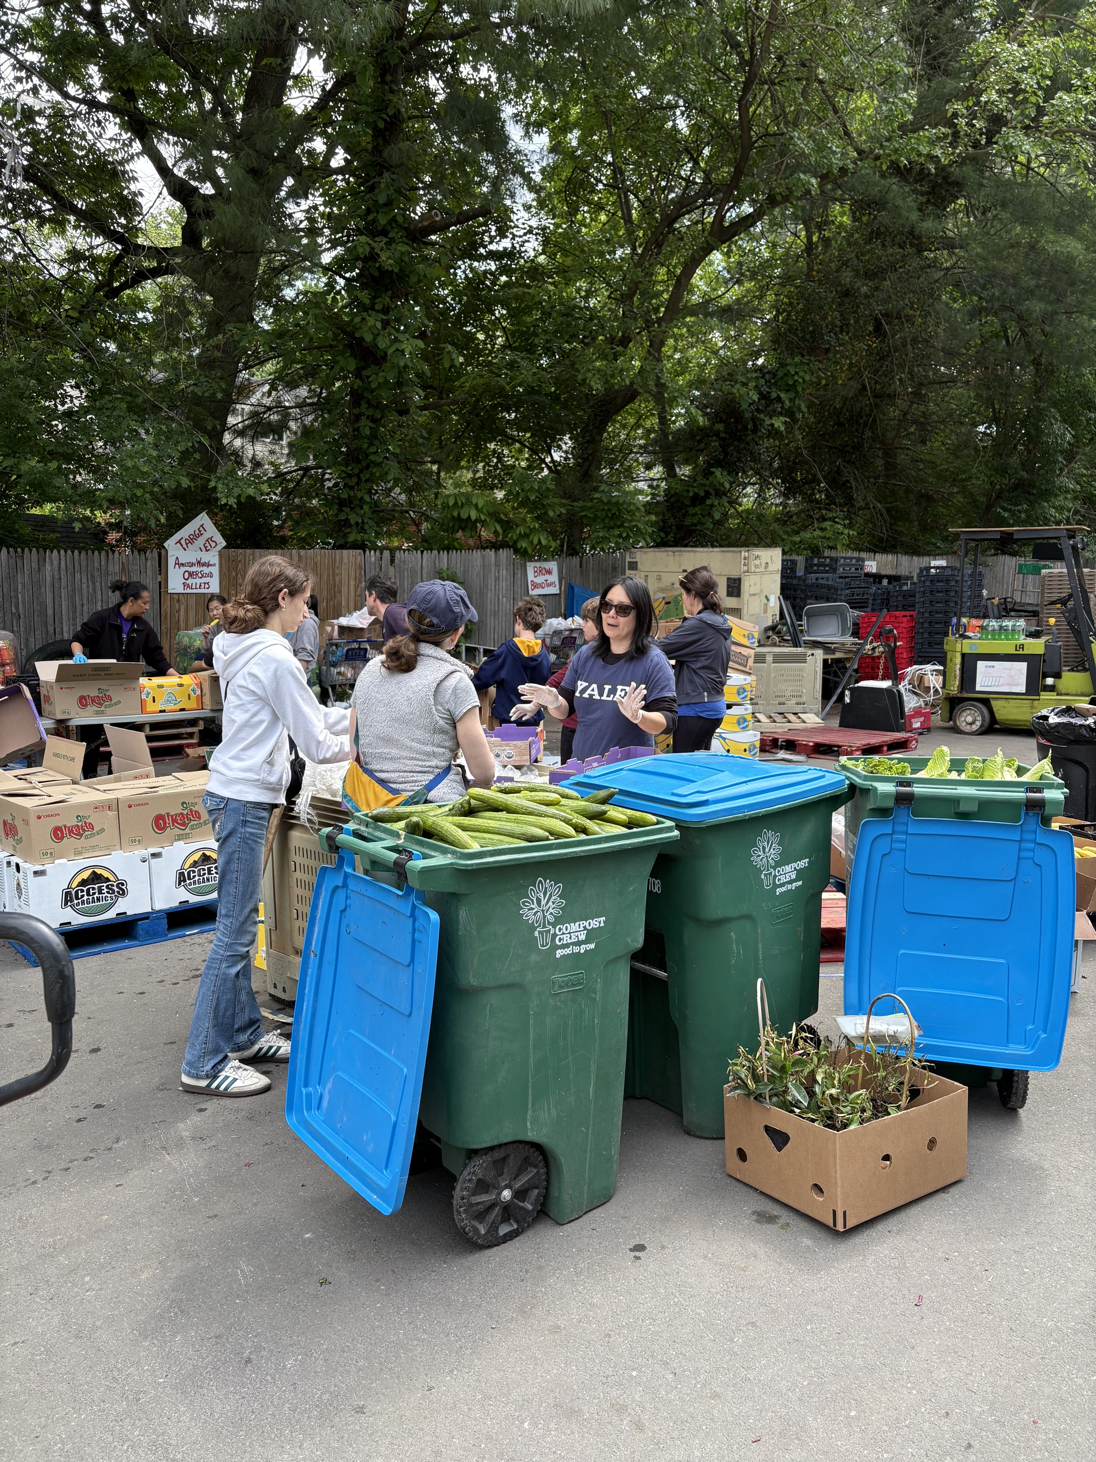
YBG Washington DC: Day of Service

Slide 16
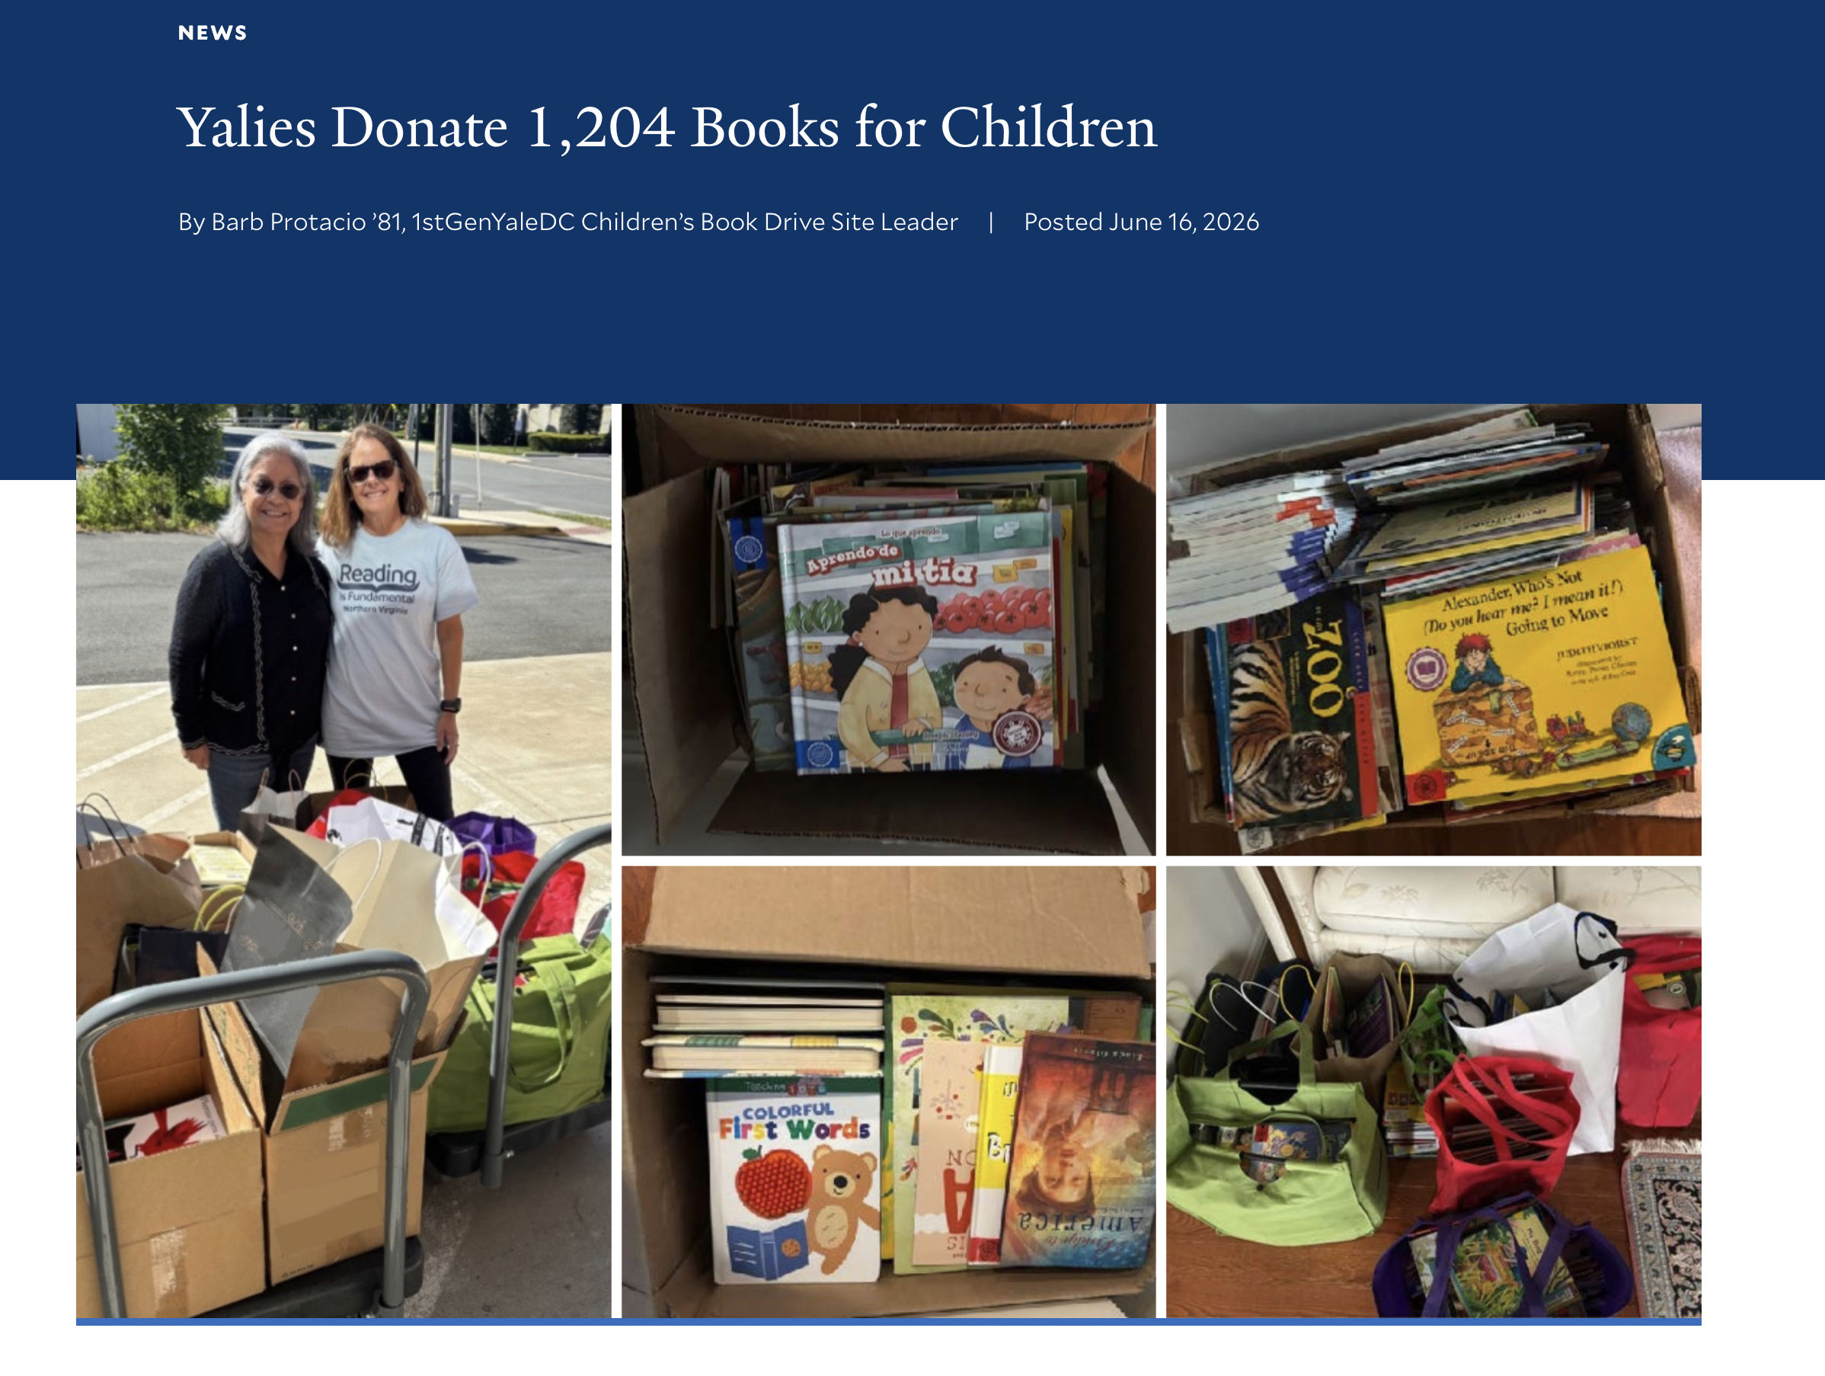
YBG Washington DC: Book Drive with First Gen

Slide 17
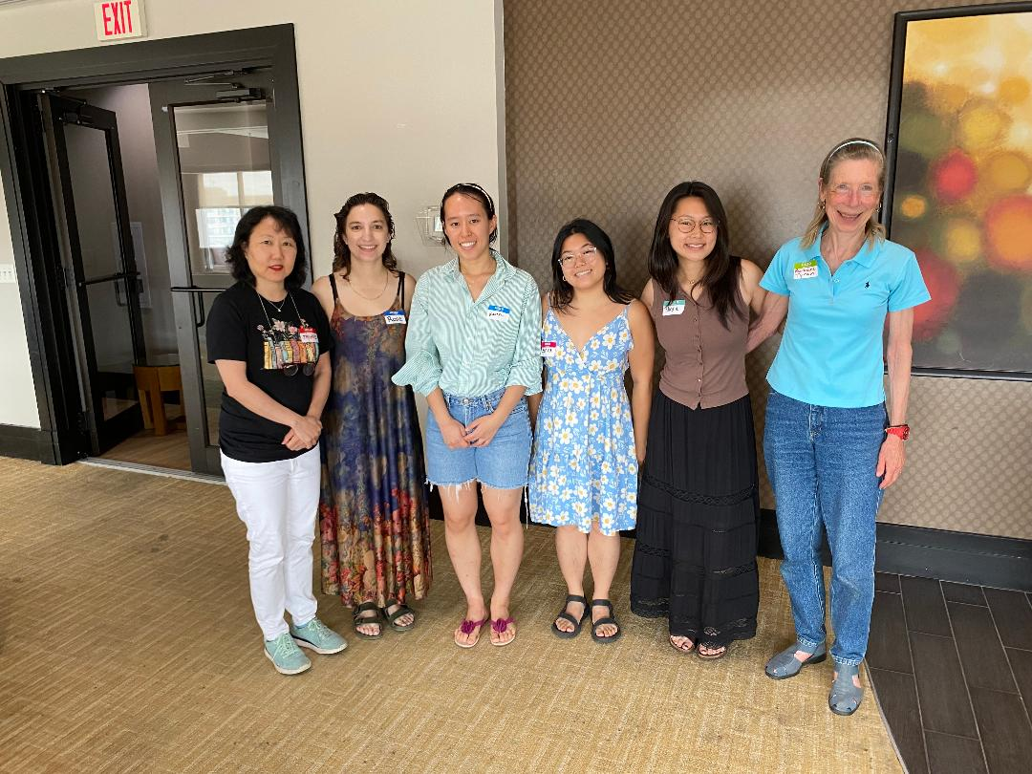
YBG Washington DC: Yale Women Partners

Slide 18
YBG Washington DC: Alumni in Tech + Climate Tech
July 2026 - Joined the DC Tech Initiative
Cross-school initiative for shared interest alumni groups in the DC area:
• Stanford Alumni in Climate Tech (ACTs)
• Harvard's HBS DC Environment & Climate Group
• Harvard Alumni for Climate and the Environment (HACE)
• Dartmouth Climate Alliance
• Yale Blue Green DC
• MIT Club of DC
Membership offers YBG DC members:
• happy hours
• field trips to local sites/environmental clean up/ etc.
• speakers/content driven events

Slide 19
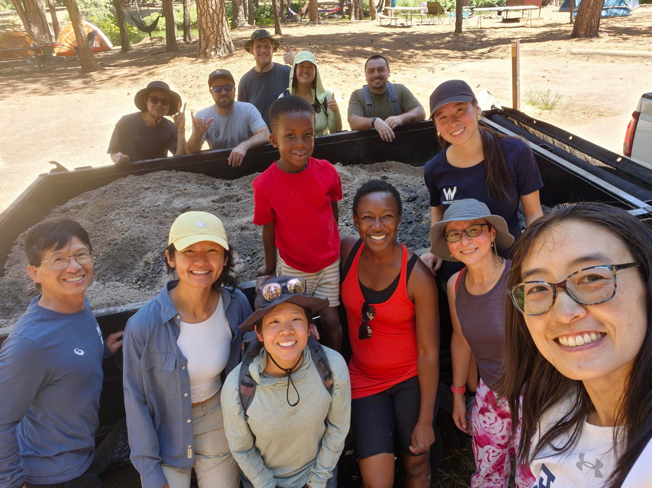
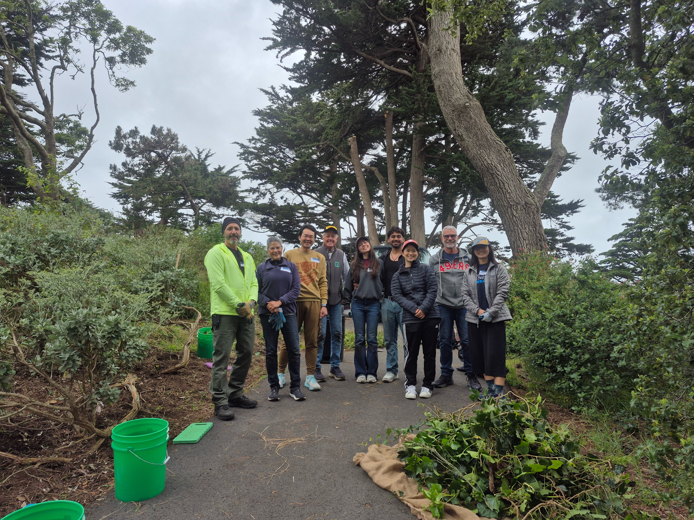
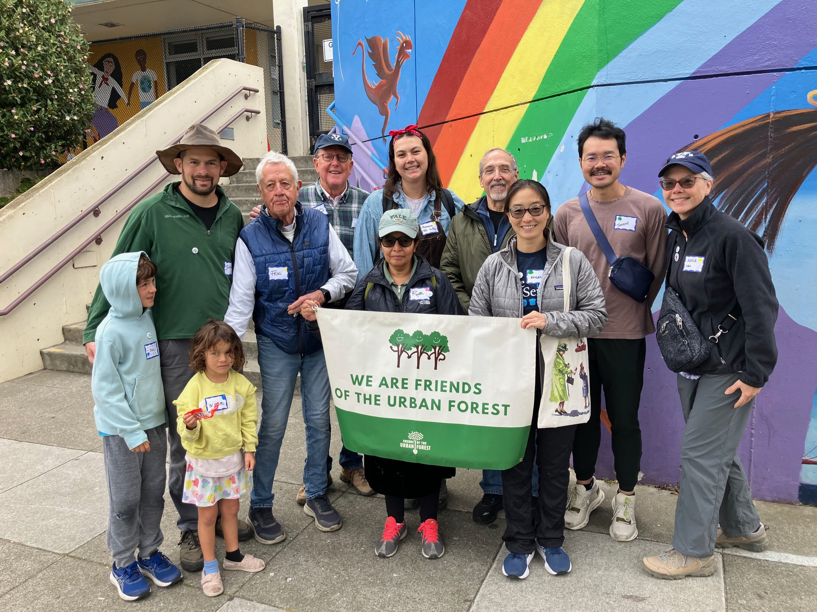
YBG San Francisco Bay Area: Days of Service

Slide 20
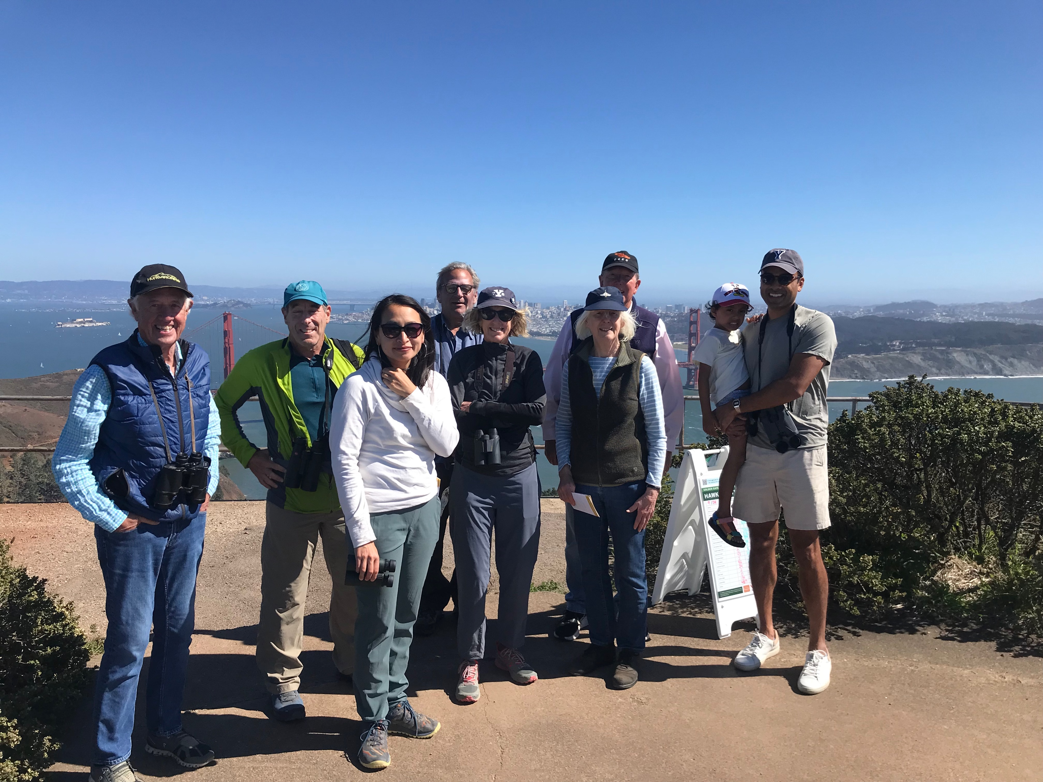
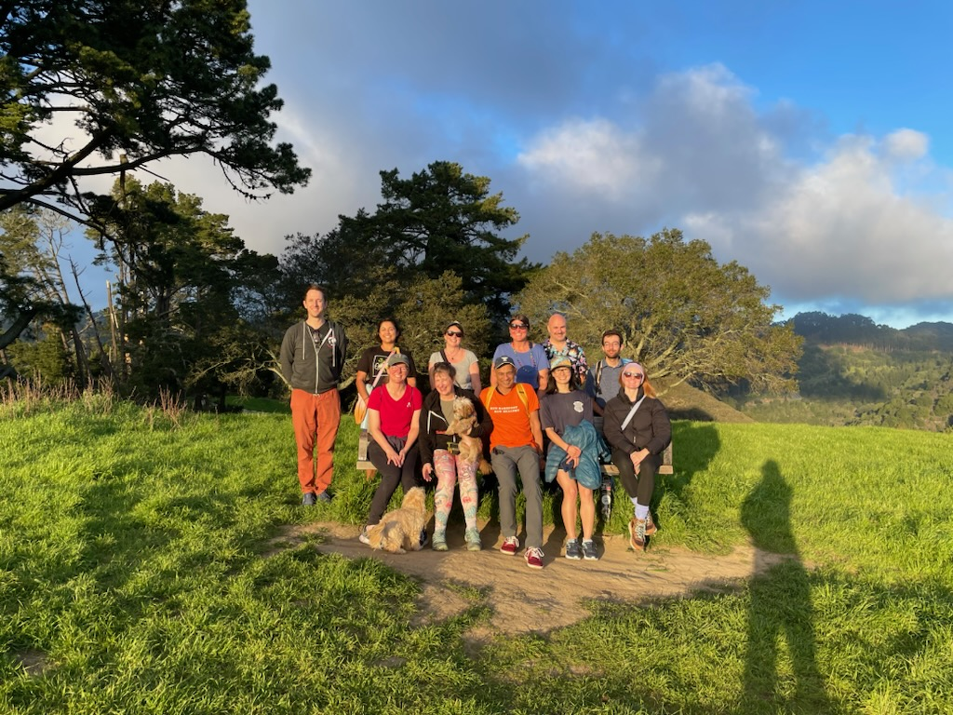
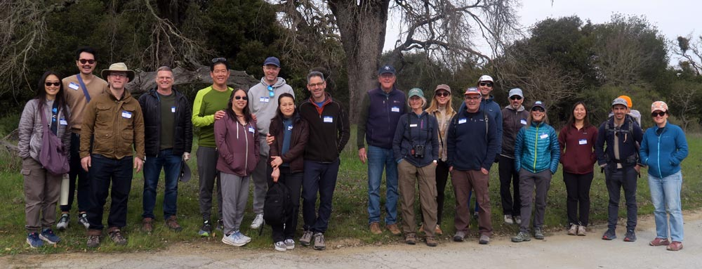
YBG SF: Time in Nature

Slide 21
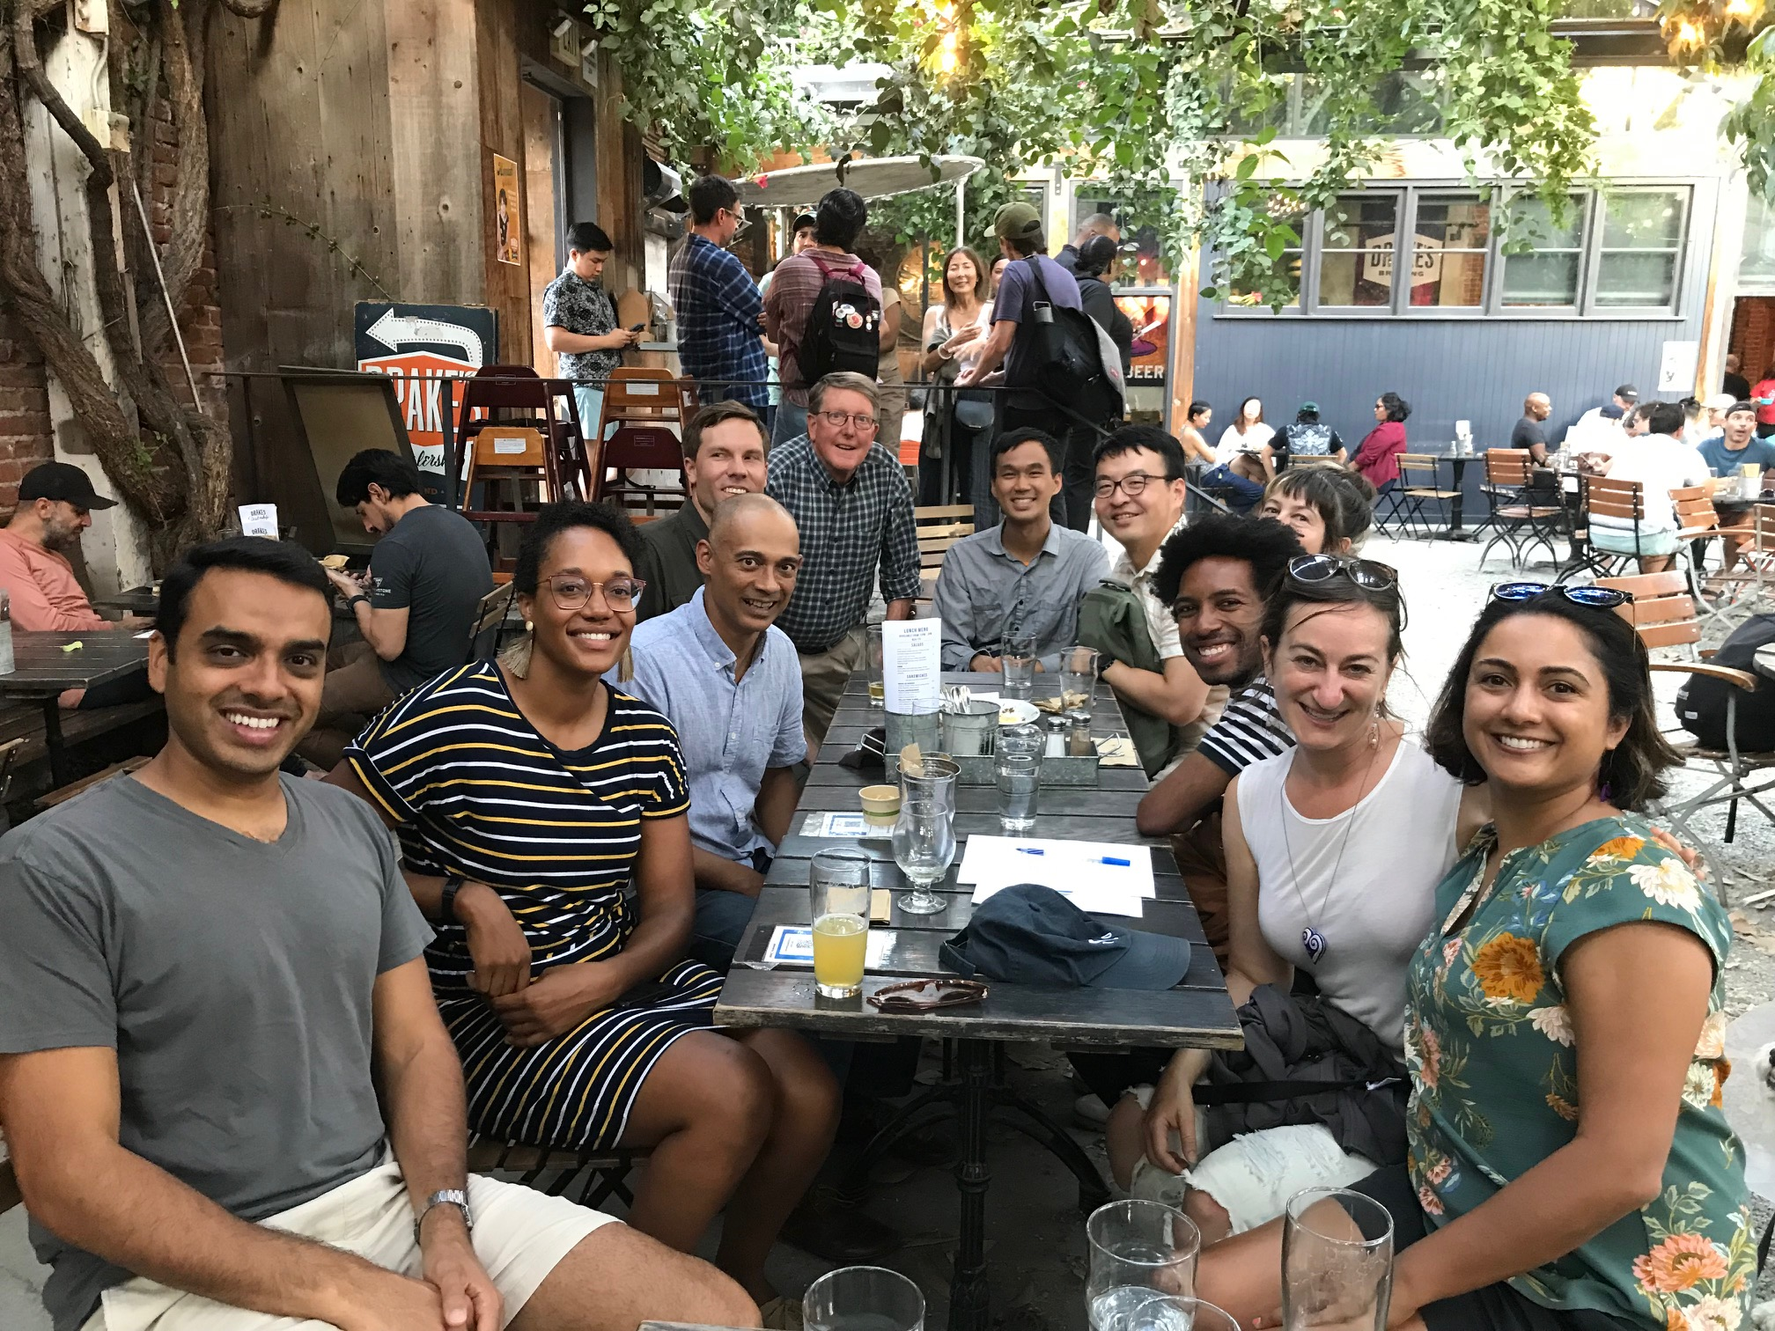
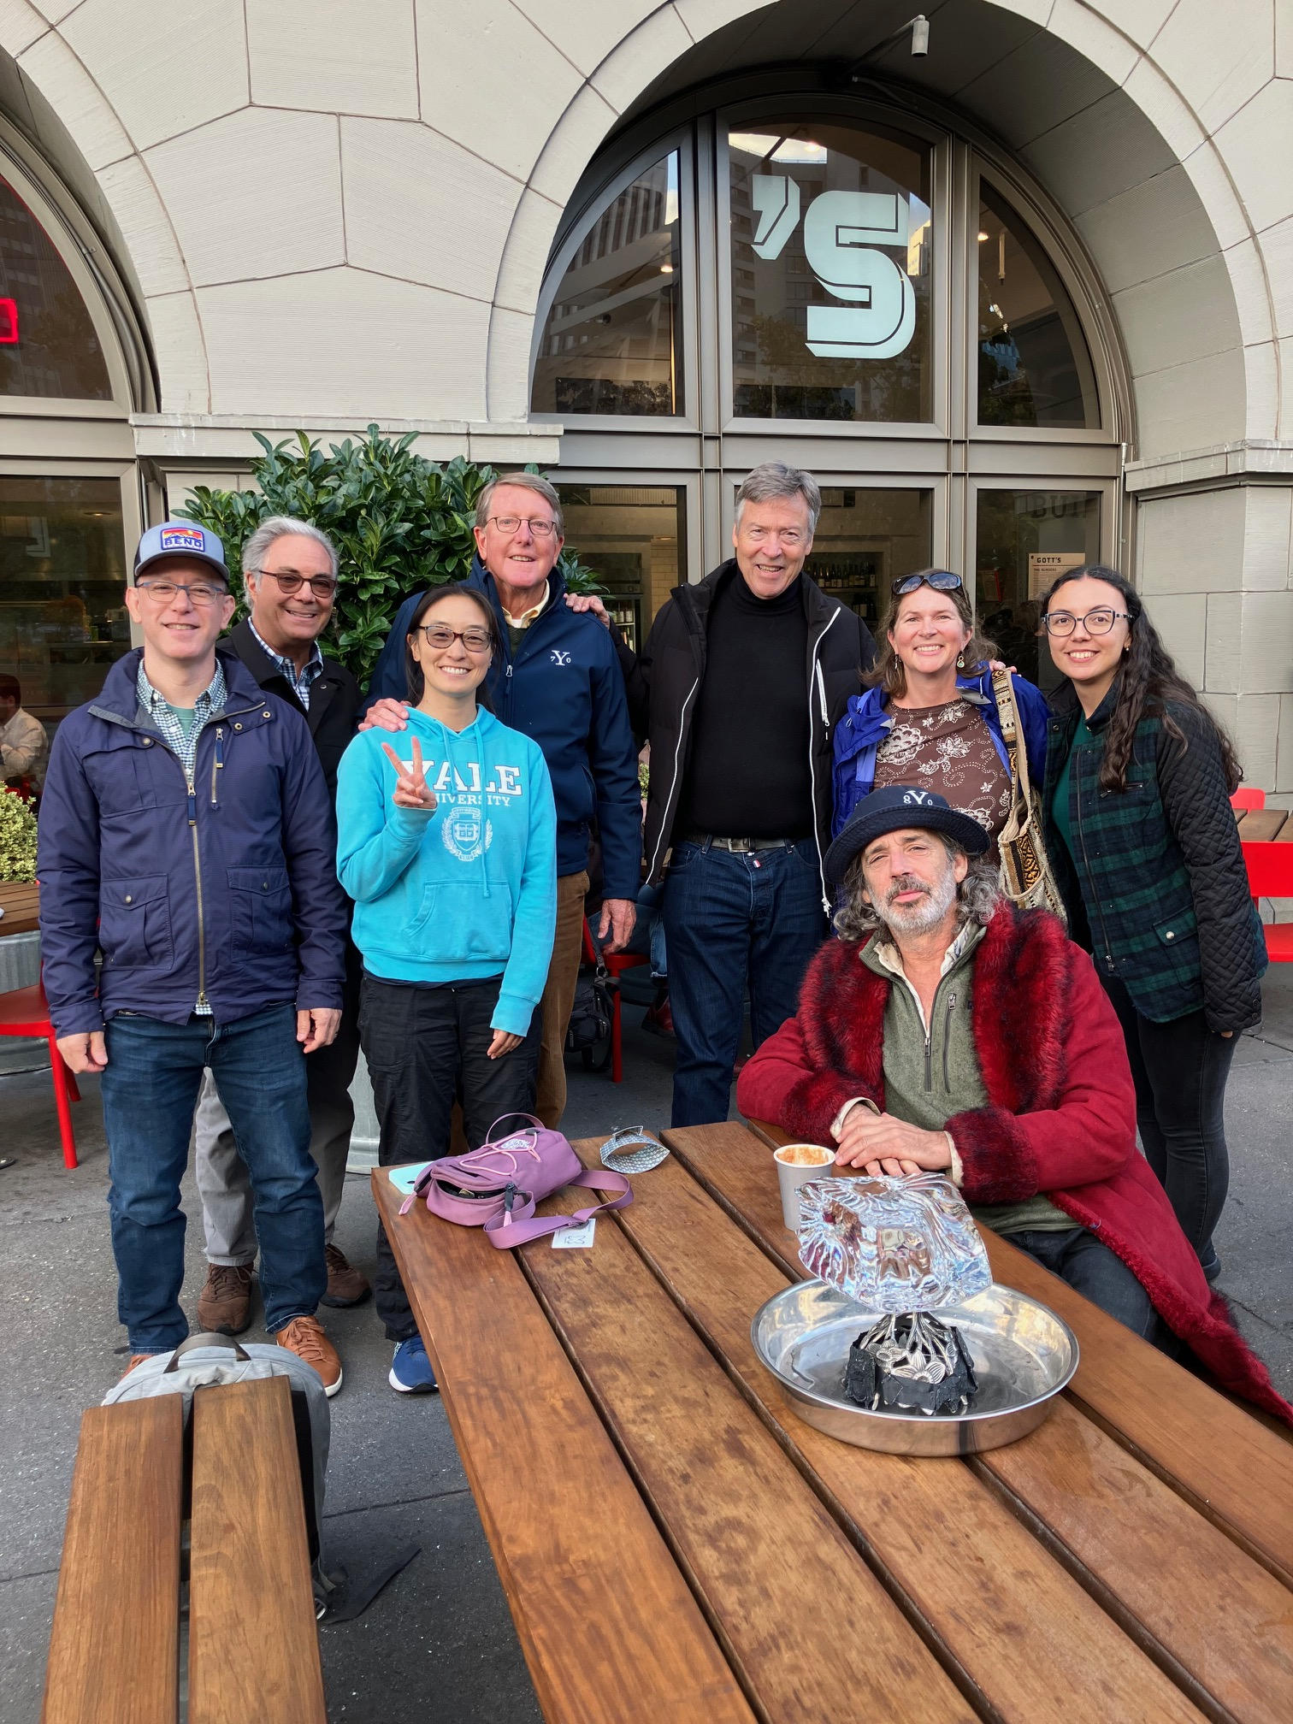
YBG SF: Networking Social Hours

Slide 22
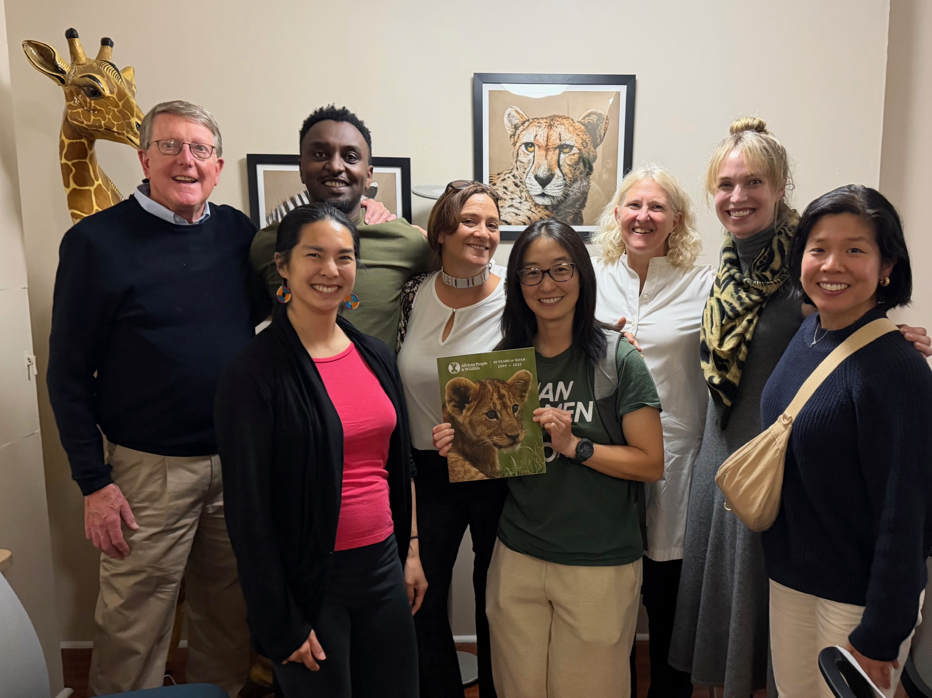
YBG SF: Conservation Partnership

Slide 23
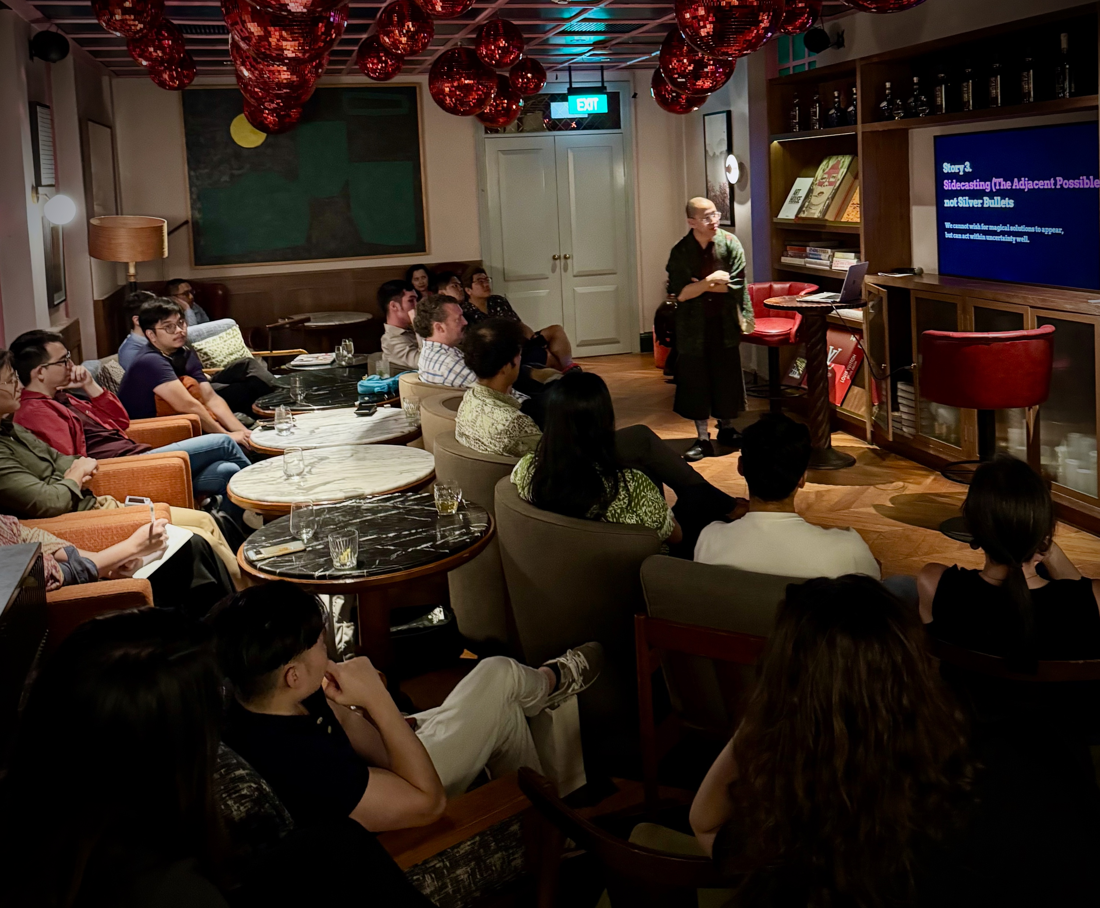
YBG Singapore: Happy Hour--Hopeful Futures

Slide 24
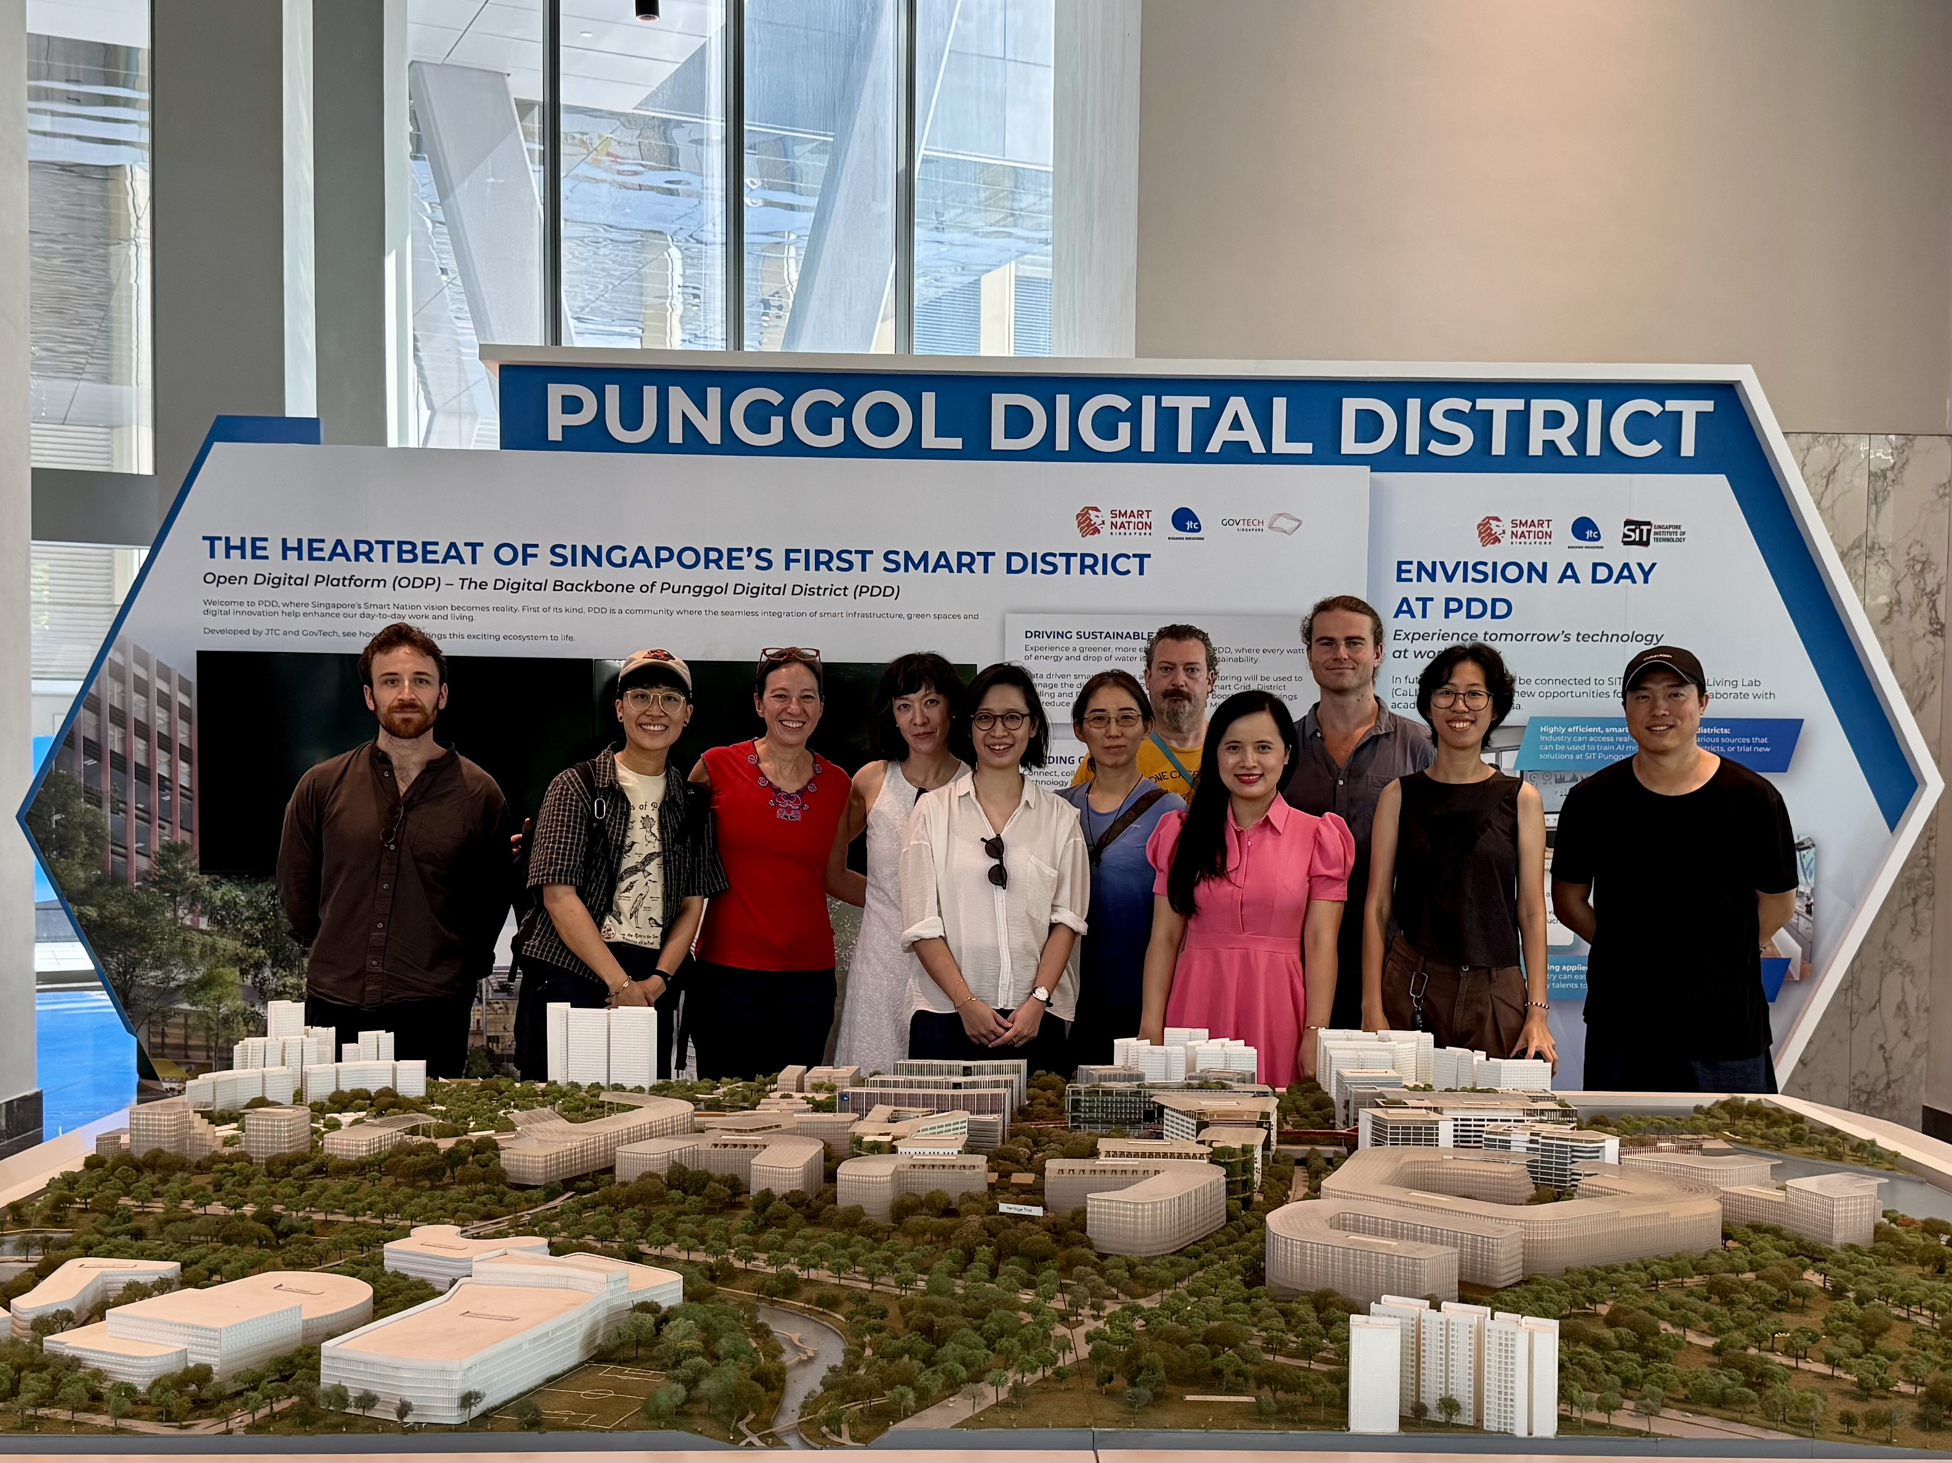
YBG Singapore: Living Landscapes for Learning—Campus Tour of SIT Punggol

Slide 25
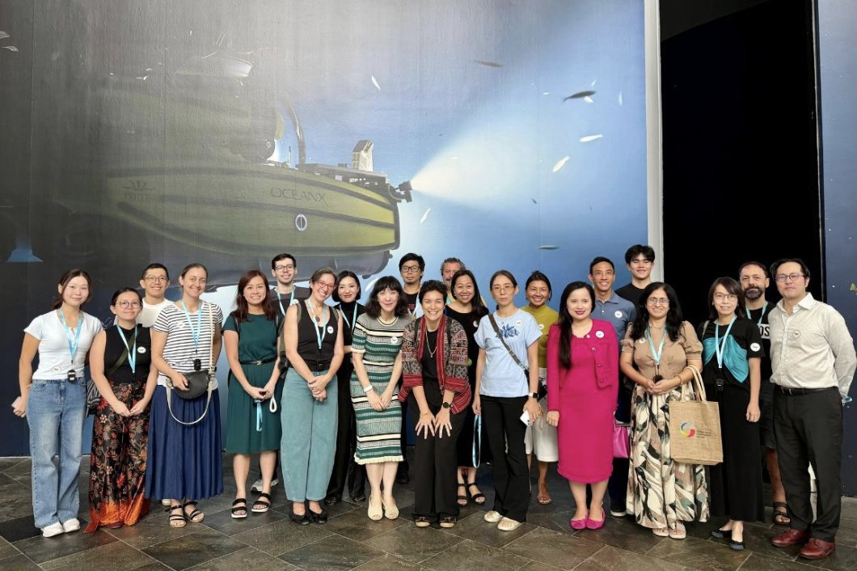
YBG Singapore: ArtScience Museum Ocean X

Slide 26
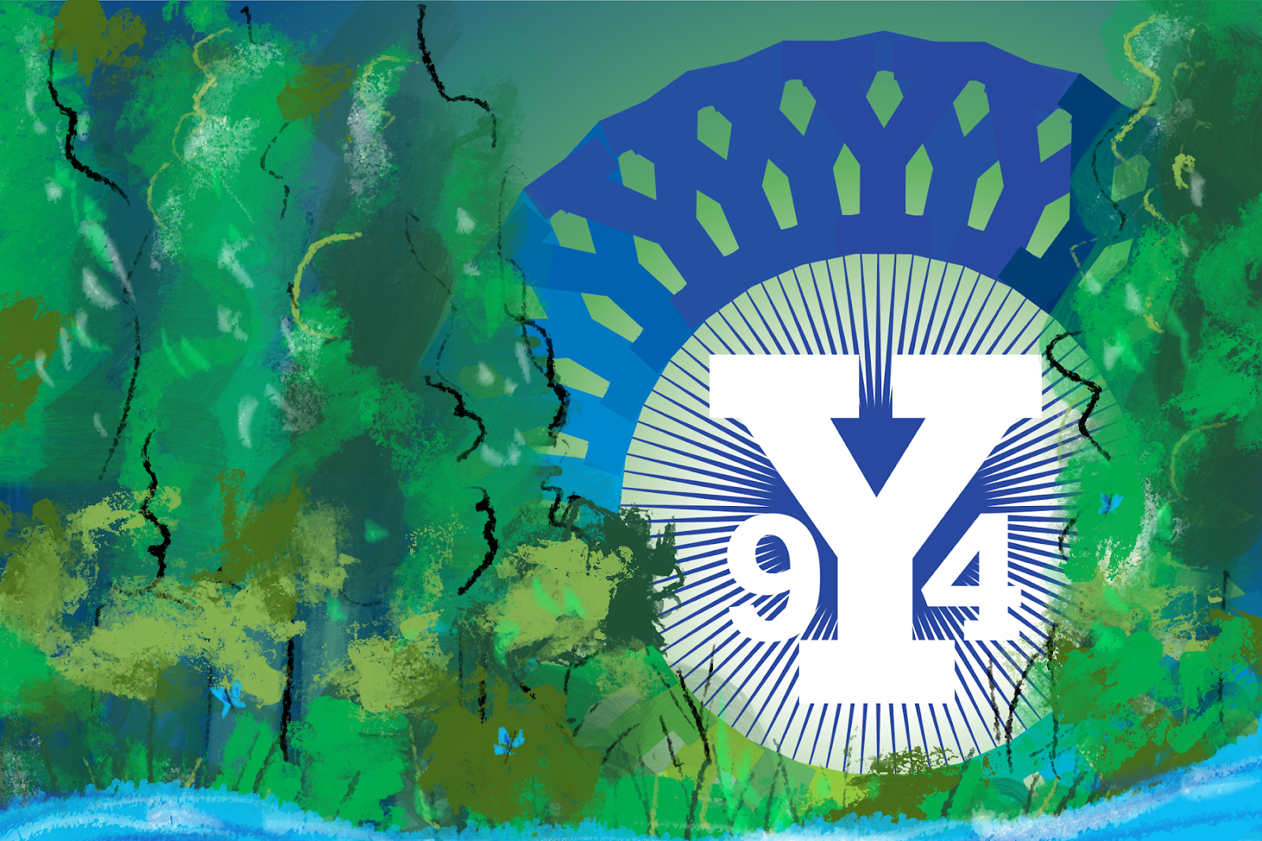
About the 9Y4 Chapter
In 2023, the Yale College Class of 1994 came together to create hope and momentum out of our collective fear and frustration around the climate crisis.
The first Yale Blue Green chapter to bring a single graduating class together to advance climate and environment related efforts, 9Y4 Climate Action is dedicated to raising awareness, deepening understanding, and creating opportunities to take climate action.
Each of us is already contributing to solutions individually—within our professional work, by supporting one another, using our influence in prosocial ways—and we see so much opportunity in harnessing our collective intelligence for even greater good.

Slide 27
YBG Chapter Plans
Yale Day of Service, May 2027, All Chapter Engagement
YBG-YDS Regional Coordinators Outreach
Climate Week Network
Support for Emerging Chapters: San Antonio, Colorado, Oregon
Continued focus on New Chapters in US, Abroad
Development of Thematic Chapters: Oceans, Energy, & the Like

Slide 28
YBG Challenges and Opportunities
Pandemic put chapters in hibernation
Full leadership change in three cities
Need to recruit additional leaders!
Demands on Yalies working fulltime
Competition with many environmental causes
BUT
This is a great way to connect with other Yalies committed to environmental sustainability. Please consider volunteering!

Slide 29
Thank you!

